Slide 1
Internet Architecture: The Role of Economy and Choice in the
Services Internet
Rudra Dutta
Computer Science, North Carolina State University
ACMU Seminar
Advanced Computing and Microelectronics Unit, Indian Statistical Institute, Kolkata
July 15, 2014

Slide 2
Overview
Internet architecture evolution
  Reasons, drivers
  Some architectural views
  Services as common theme of Internet future
Economy in the Internet
  ChoiceNet project
  Verification as a service
  General service insertion
  The impact of choice
  Ongoing work
Other areas

Slide 3
Evolution of Structure
Initially, an adaptation of the hierarchical structure of POTS
  But with flexibility in topology at each level
Number of levels also flexible
  Core routing phase of the Internet
  Core also called “backbone”
ARPANET, NSFNET
Lab, public service, business, commerce

Slide 4
Network Service Demand Evolution
Optical substrates and backbones lie at the core of almost all planetary communications
Internet, mobile internet, mobile content access, form increasingly significant part of it
Large short-fuse file transfers form significant part of it
Larger range of bandwidth needs
More diverse timescales
Desire for more buying options, green options

Slide 5
Network Service Offering Evolution
Different backdrop in different countries
  Single national (government or otherwise) backbone providers (with or without smaller collaboration/competition)
  Private regional/national providers, tiers
Fiscal responsibility
  Desire to near-optimally utilize installed capacity
  Install capacity only when fairly sure of business
  Desire to keep control of their own equipment
  Desire for uniformity of offerings – “shop window”
Necessity / obligation to connect to “Internet”
Slow to make new offerings, leverage innovative technology

Slide 6
Economics
“Now there is money, and money changes everything”
  Rather, goals / accountability has changed
Who pays for the Internet? What do they get out of it?
  Partly public, partly private equipment

Slide 7
Network Neutrality
Two considerations conflated?
Money/resources has and will always have power
  More money has more powerEqual or even less money wielded by coordinated policy (big corp) has more power
  Useless (or even unworthy?) to argue against
"Unfair" leveraging of common resources
  Networking is fundamentally distributed
  Just because I control the router, I can rewrite policy - but the power of my router depends on many other resources for realization
  IPX model - small group agreeably coexisting under agreed-upon policy?
Becomes unfair when hooking up to comparatively more publicly funded resources
  (Even if receiving no direct funding for it?)

Slide 8
What Constitutes Neutrality
Unequivocal definition (in concrete measurable terms) hard to come by
FCC definition criticized for being too vague
But others seem defined in intensional or antecedent terms rather than measurable or consequent ones
  "Non-discriminatory"
  "provider policy completely detached from traffic"
Others are very concrete and verifiable but seem draconian - and unenforceable or in other cases unguaranteeable
  Must FCFS all packets
  Users should be able to access any web content
In its vagueness, FCC may have got it right
  Up to the community to further refine, and define metrics

Slide 9
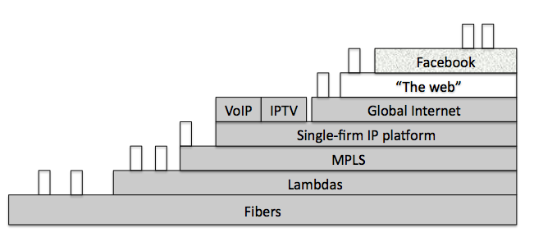
Economics Drives Architecture
From “Platform Models for Sustainable Internet Regulation”, [Claffy and Clark, SSRN 2014]

Slide 10
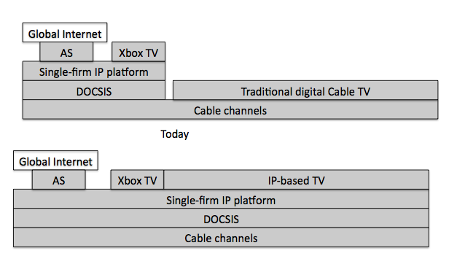
Economics Drives Architecture

Slide 11
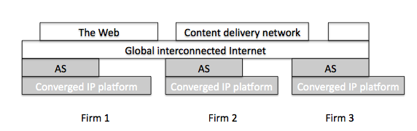
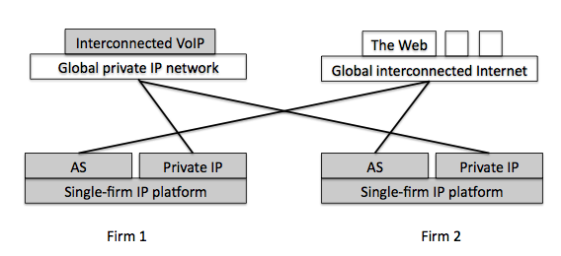
Economics Drives Architecture

Slide 12
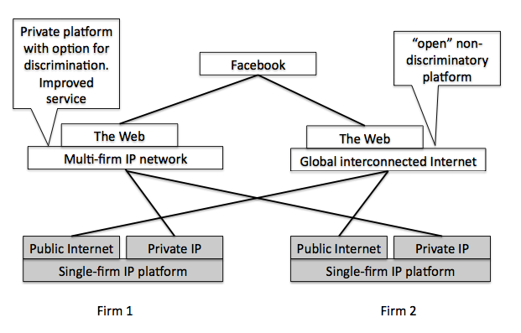
Economics Drives Architecture

Slide 13
Architectural Problems
Architectural entities provide natural “roles” for players in distributed multi-owner systems
  Interfaces provide natural “cut-points”
  Allows eco-system to form, evolve, respond
Architectural problem considerations
  Are there missing entities? Redundant entities?
  Are the entity separations “natural” (is there good motivation for each “role”)?
  Are there under-defined / over-defined interactions?
ChoiceNet: explicit architectural entities/interactions for choice, economy
Notes:
Maybe OSI failed because of lack of roles

Slide 14

Performance Woes
Stupid computer.
Stupid network.
Informed exercise of choice (backed by money) can reward providers with good performance
Select for helpful providers, beneficial ecosystem

Slide 15
Architectural Need
Encourage
Alternatives
Vote with
Your Wallet
Know What
Happened
Informed exercise of choice (backed by money) can reward providers with good performance
Select for helpful providers, beneficial ecosystem

Slide 16
ChoiceNet Entities / Interactions
Consumer – willing to exchange consideration for services deemed of value
  User who exercises choice → “chuser”
Provider – provides services in exchange of consideration
  HW/SW infrastructure provider (path service)
  Marketplace provider
  Composition provider
  Verification provider
😊
😃
Notes:
Without these, the ecosystem does not work
Other non-critical ones: storage service provider, in-flight compute,

Slide 17





Entities and Interactions
Marketplace
Search
-- | ------- | -------
-- | ------- | -------
-- | ------- | -------
-- | ------- | -------
-- | ------- | -------
Search
Advertise
Planner
😊
Help Plan
😃
Purchase
Customer
Verify
Measurements
Provider
Provision
Monitor
Analyzer
👀
Use
Service
Informed exercise of choice (backed by money) can reward providers with good performance
Select for helpful providers, beneficial ecosystem
Encourage
Alternatives
Vote with
Your Wallet
Know What
Happened

Slide 18
Per-Provider Contracts
😊
Contracts
👀
Contracts
👀
👀
Service Composition
Plan-Provision-Use
Marketplace provides rendezvous
Planning (by customer or separate service) identifies composite candidates
Separate contracts with each provider
Provisioning and token on purchase

Slide 19
Marketplace as Rendezvous
Withdraw/update listings/prices
Retrieve service offerings
Configure, reconfigure, list offerings
Retrieve interest responses
Provider
Marketplace
Customer
Retrieve customer interests
Express interest, reviews
Update resource availability
Make buying decision
Notes:
“Demand-grooming” and “Offering-grooming”

Slide 20
Preliminaries
Some existing issues retain importance or assume increased importance with ChoiceNet
Cannot be totally ignored
  But need not be reinvented from wheel up
Set of bootstrapping assumptions that articulate the “root” enablement of such issues outside (before) ChoiceNet
  “As in current practice”

Slide 21
Prelim: ChoiceNet Rendezvous
Rendezvous bootstrap assumption
  DNS names or similar URLs exist
  ICANN (or equivalent (exists)
  URL for some major marketplace providers’ economy plane interfaces are well-known
    Through web, yellow pages, or equivalent
    Possibly through ICANN-maintained meta-marketplace (public service listing service)
  Broadly reachable commodity network enabling DNS-based communication exists (public Internet)
    Possibly as public service

Slide 22
Prelim: ChoiceNet Identities
Identity bootstrap assumption
  Entities (customers, providers, services) have identities
  Identities are obtained by registration with authority, and unique under authority
    Top-level: national governments, ICANN, chambers of commerce, UN?
  Registration includes URL of public key of entity
    Currently missing
    Possibly also entity’s economy plane “speaker” URL
  Authority is hierarchical
    ICANN names provider, provider names service

Slide 23
Prelim: ChoiceNet Message Fields
Attribute/Value/URL triple Convention
Attribute
  Must use a word from
  current vocabulary
Value
  Numerical value, OR URL for full value, OR another message field
URL
  Location of authoritative definition of vocabulary for “value”
  Where you can go to download , if you don’t have it
  ICANN URLs, for ChoiceNet “standard” vocabulary; others, for custom extensions (likely NULL for numeric)
Attribute Name
Value
Vocab URL

Slide 24
ChoiceNet Message Structure
CN Version
1.0
http://…
ALL ChoiceNet messages follow same basic structure, which is hierarchical
  Version and message type must exist
  Originator name, signature, type must exist
  Additional fields appropriate (expected) for message type
  Values of some fields may be other sets of fields
  Special field to list remaining attribute fields (of this level)
  Expected in this order, but order may not matter
Semantics expressed in some appropriate syntax
Encapsulated in some appropriate transport with corresponding addressing (IPv4, UDP, … IPv6?)
  (“There are many ChoiceNets”)
Originator Name
“NN”
http://…
Originator Sig
“NN”
http://…
Originator Type
“NN”
http://…
Mesg Type
“QQ”
http://…
<Mesg Specific>
“DD”
http://…
Added Attribs
<list>
http://…

Slide 25
ChoiceNet Rendezvous Message
ChoiceNet vocab version/URL
Identify originator, originator entity type, provider type (if entity type is provider)
  Desired provider type to rendezvous with
  Request response
I speak CN 1.0, am provider “AA” of type “transport”, looking for provider of type “marketplace”
CN Version
1.0
Orig Type
“Provider”
I speak CN 1.0, am provider “MM” of type “marketplace”
Mesg Type
“Rendezvous”
Orig Provider Type
“Transport”
Originator Name
“AA”
Rendezvous target
“Marketplace”
Self-certification
<signature>

Slide 26
Advertisements
Request to List
Consideration
Advertisement Description
?
Listing confirmation
?
Token

Slide 27
Per-Provider Verification
😊
Contracts
👀
Contracts
👀
👀
Third-party verification
A possible measurement service: timestamp marker packets
  Packets recognized by flow, and shim header inserted by companion code at source
  Can be split off, not necessarily in-flight at wire-speed
GENI and NS-3 prototypes

Slide 28
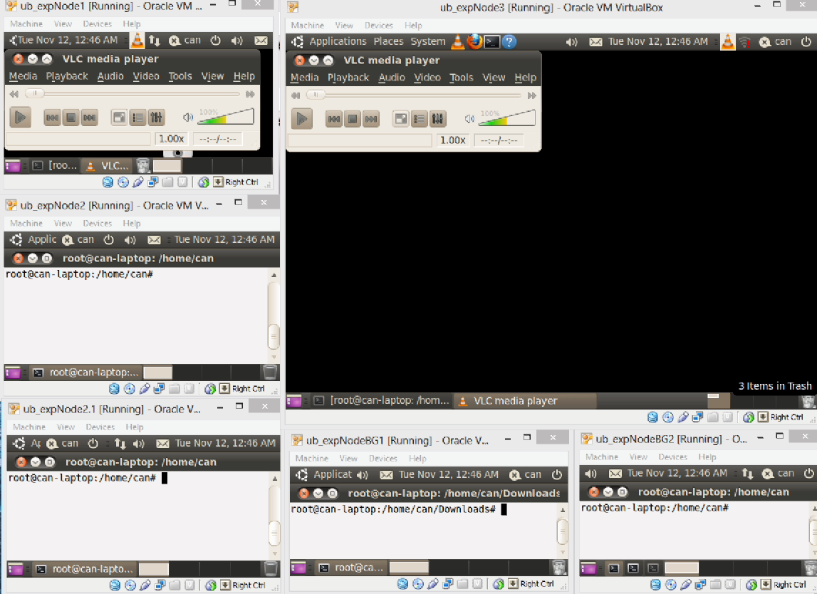
Prototype Demo

Slide 29
Jitter Apportionment for Video UX
Raw MD Figures
Time (s)
Time (s)
Marker Sequence Number
Marker Sequence Number
Close-up

Slide 30
Jitter Apportionment for Video UX
Normal

Slide 31
Jitter Apportionment for Video UX
Congestion
at NSP1

Slide 32
Jitter Apportionment for Video UX
Relatively better

Slide 33
Jitter Apportionment for Video UX
Congestion starts
at NSP3
Back to
normal

Slide 34
Jitter Apportionment for Video UX

Slide 35
Jitter Apportionment for Video UX
A freeze
A glitch
Glitches denote the losses and Freezes denote video playback freezes

Slide 36
Jitter Apportionment for Video UX
Contributing One-Way-Delay per Provider
No contributing delay at NSP2

Slide 37
Jitter Apportionment for Video UX
Contributing One-Way-Delay per Provider
No contributing delay at NSP2
Basic Analysis Results
Provider | Mean Jitter % | Std. Dev. Jitter % | Max Jitter %
NSP1 | 44.6 % | 32.8 % | 25.3 %
NSP2 | 0.2 % | 0.3 % | 0.2 %
NSP3 | 55.2 % | 66.9 % | 74.5 %

Slide 38
Jitter Apportionment for Video UX
Analysis for freeze 1 [t=6 and t=10]
Freeze 1 is at t=8s
Delay (ms)
 | Mean % | Std dev % | Max J %
NSP1 | 96.7 % | 93.8 % | 94.7 %
NSP2 | 0.2 % | 0.6 % | 0.2 %
NSP3 | 3.1 % | 5.6 % | 5.1 %
Freeze 2 is
at t=10s
Analysis for freeze 2 [t=8 and t=12]
 | Mean % | Std dev % | Max J %
NSP1 | 98.5 % | 97.2 % | 97.2 %
NSP2 | 0.0 % | 0.0 % | 0.0 %
NSP3 | 1.5 % | 2.8 % | 2.8 %

Slide 39
Jitter Apportionment for Video UX
Delay (ms)
Freeze 3 is at t=19s
Analysis for freeze 3 [t=17 and t=21]
Freeze 4 is
at t=26s
 | Mean % | Std dev % | Max J %
NSP1 | 27.7 % | 42.2 % | 50.2 %
NSP2 | 0.2 % | 0.4 % | 0.3 %
NSP3 | 72.1 % | 57.4 % | 49.5 %
Analysis for freeze 4 [t=24 and t=28]
 | Mean % | Std dev % | Max J %
NSP1 | 14.0 % | 13.8 % | 13.6 %
NSP2 | 0.2 % | 0.2 % | 0.2 %
NSP3 | 85.8 % | 86.0 % | 86.2 %

Slide 40
Service Insertion
Value-added services must be possible to provide at intermediate points of use plane data flow
  Without requiring extraordinary non-service infrastructure
Separation of hardware (infrastructure provider) and software (service provider)
  Similar to NFV
Requires recognizing application-layer semantics, and ability to provide differential service on that basis
  Obvious match for SDN

Slide 41


Slide 43
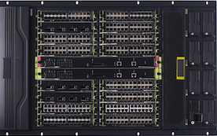

Slide 44

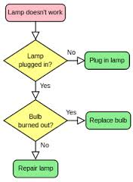

Slide 45
7
4
TCP
UDP
3
IP
2
IEEE 802
1
7
7
7
4
TCP
UDP
4
TCP
UDP
4
TCP
UDP
7
7
7
3
IP
3
IP
3
IP
4
TCP
UDP
4
TCP
UDP
4
TCP
UDP
7
7
7
2
IEEE 802
2
IEEE 802
2
IEEE 802
3
IP
3
IP
3
IP
4
TCP
UDP
4
TCP
UDP
4
TCP
UDP
1
2
IEEE 802
1
2
IEEE 802
1
2
IEEE 802
3
IP
3
IP
3
IP
1
2
IEEE 802
1
2
IEEE 802
1
2
IEEE 802
1
1
1

Slide 46
7
4
TCP
UDP
3
IP
2
IEEE 802
1

Slide 47
7
4
TCP
UDP
3
IP
2
IEEE 802
1

Slide 48
7
4
TCP
UDP
3
IP
2
IEEE 802
1
IMAP
SIP
LDAP
SSH
HTTP
FTP
7
SDP
DNS
IRC
4
TCP
UDP
3
IP
2
IEEE 802
1

Slide 49
IMAP
SIP
LDAP
SSH
HTTP
FTP
7
SDP
DNS
IRC
4
TCP
UDP
3
IP
2
IEEE 802
1

Slide 50
?

Slide 52
7
HTTP
7
4
TCP
UDP
3
IP
2
IEEE 802
1

Slide 55
+
Extensions
OF
“Helper” (EPB)
DPI
DPI rules

Slide 56
Scheduling
DPI
SaaS
Transcoding

Slide 57
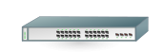

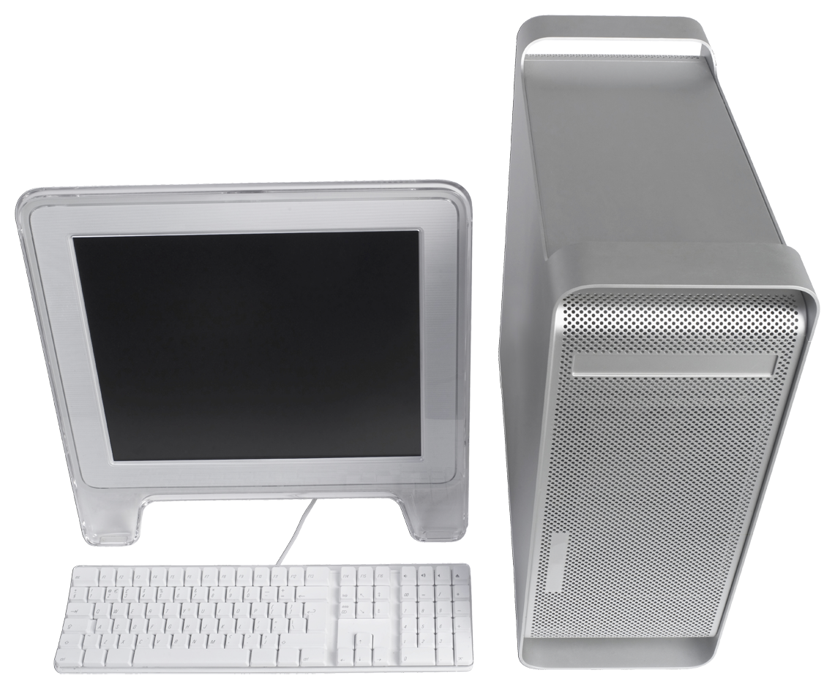
Experiment – Real World Scenario
PC 1
Multimedia Server
Legend
Best-effort Route
Expedited Route
Notes:
The logical topology for our experiement

Slide 58

Experiment – Lab Setup
Control Plane
Controller
OpenFlow
Datapath
Traffic Controller 1
Traffic Controller 2
EPB
Data Plane
PC 1
Multimedia Server
Legend
Best-effort Route
Expedited Route
Notes:
Physical Topology behind our experiment

Slide 59
Points to Note
No special or proprietary hardware
No endpoint signaling / action necessary
Open, reusable extension in
OF-recommended manner
General approach to OF-compatible service insertion

Slide 60

Prototype Demo

Slide 61
Test Scenarios
Test | Condition
A | Baseline, no Traffic Controller or EPB involved
B | EPB with Traffic Controller 1 activated
C | EPB with both Traffic Controllers activated
D | Only Traffic Controller 1 activated
E | Both Traffic Controllers activated
F | EPB with Traffic Controller 1 and Expedited Routes activated
G | EPB with both Traffic Controllers and Expedited Routes activated

Slide 62
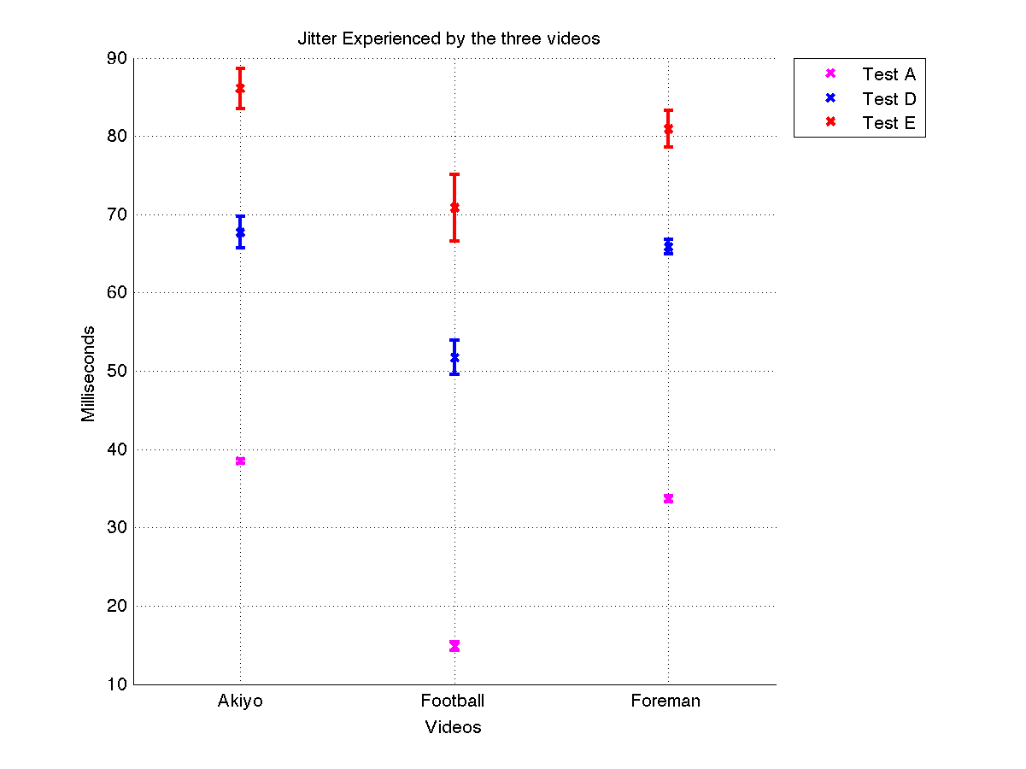
Jitter Experienced by the three videos
Test | Condition
A | Baseline
B | EPB + TC1
C | EPB + TC1, TC2
D | TC1
E | TC1, TC2
F | EPB + TC1 + DPI
G | EPB + TC1, TC2 + DPI

Slide 63
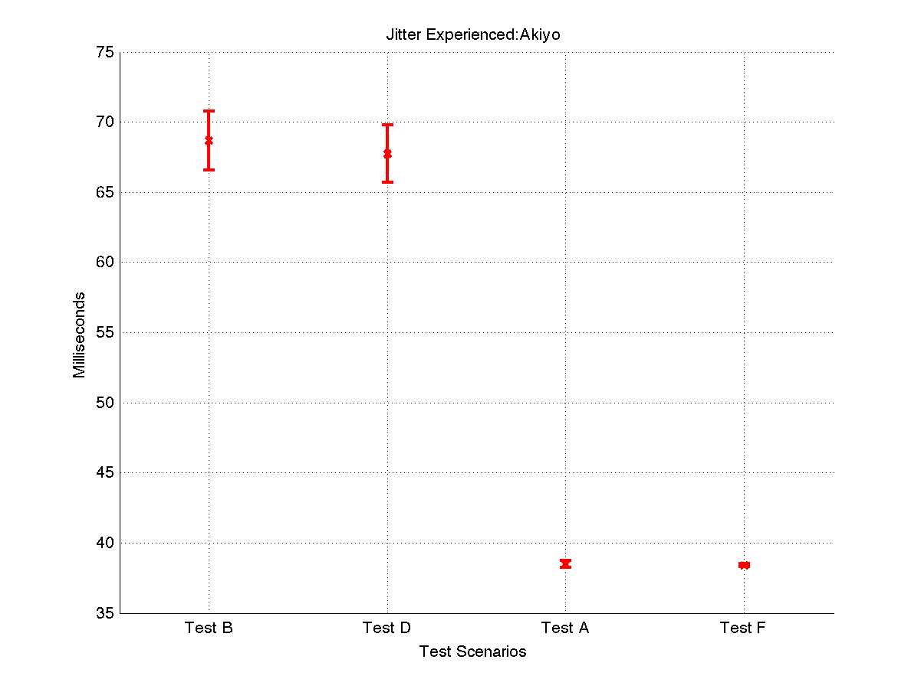
Jitter
Test | Condition
A | Baseline
B | EPB + TC1
C | EPB + TC1, TC2
D | TC1
E | TC1, TC2
F | EPB + TC1 + DPI
G | EPB + TC1, TC2 + DPI

Slide 64
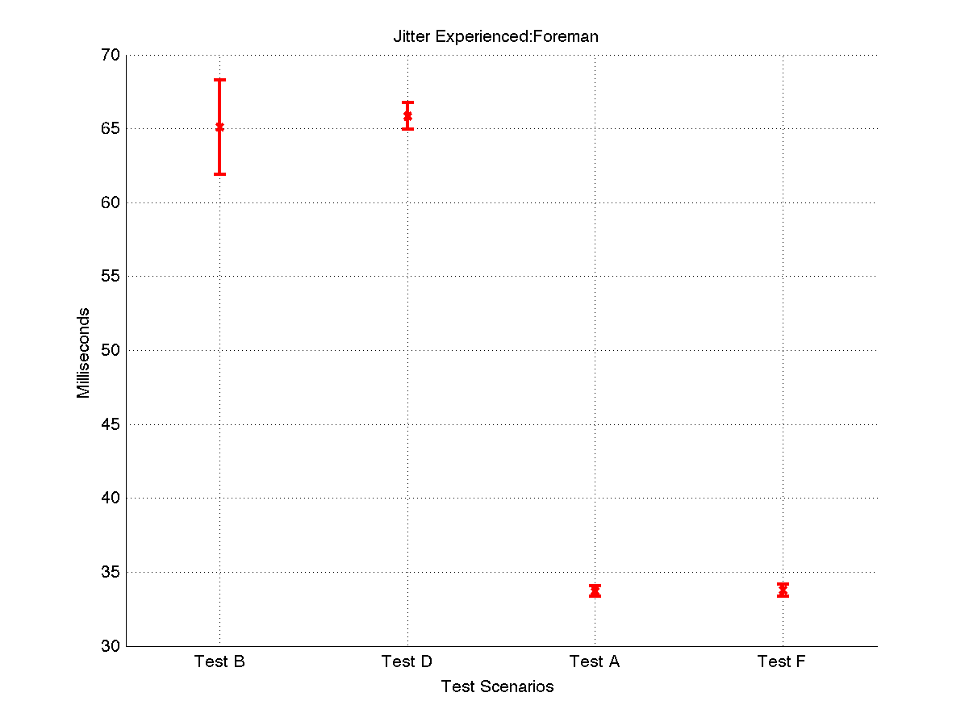
Jitter
Test | Condition
A | Baseline
B | EPB + TC1
C | EPB + TC1, TC2
D | TC1
E | TC1, TC2
F | EPB + TC1 + DPI
G | EPB + TC1, TC2 + DPI

Slide 65
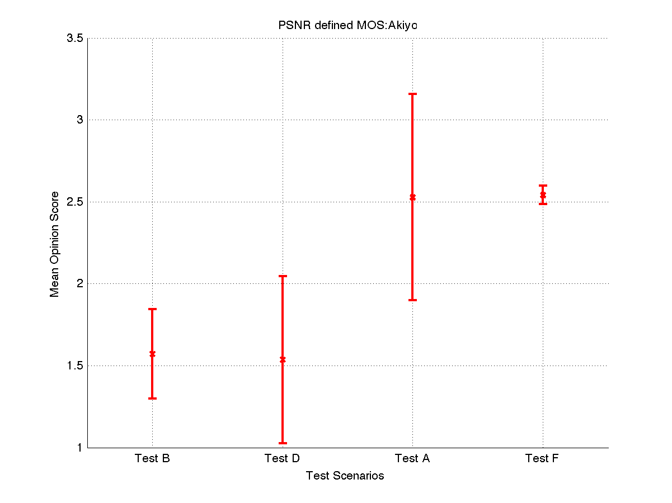
PSNR-MOS Score
Test | Condition
A | Baseline
B | EPB + TC1
C | EPB + TC1, TC2
D | TC1
E | TC1, TC2
F | EPB + TC1 + DPI
G | EPB + TC1, TC2 + DPI

Slide 66
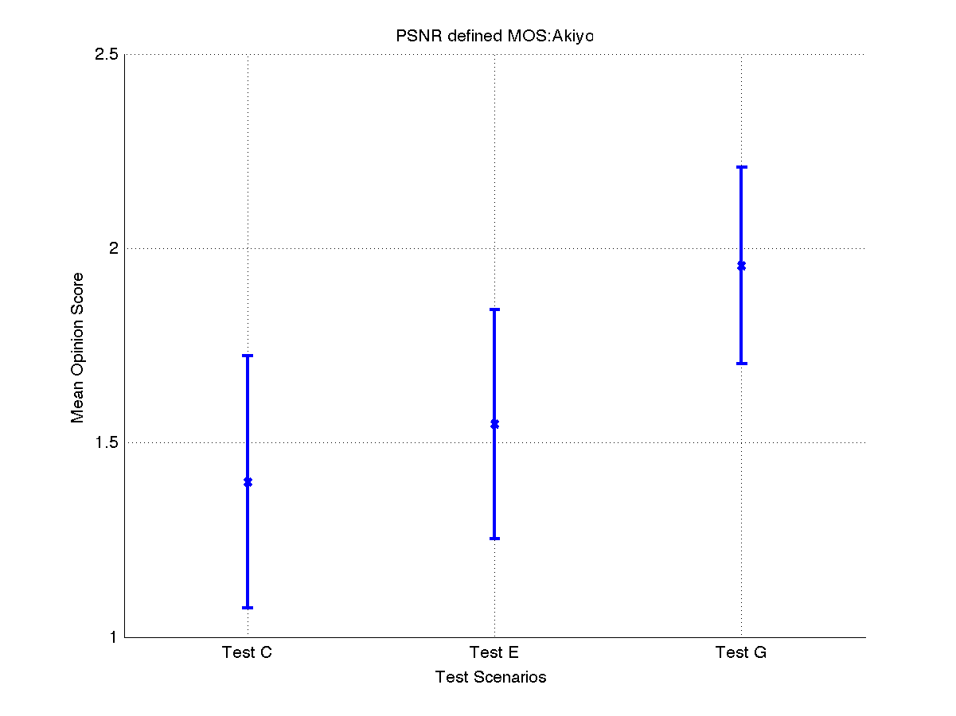
PSNR-MOS Score
Test | Condition
A | Baseline
B | EPB + TC1
C | EPB + TC1, TC2
D | TC1
E | TC1, TC2
F | EPB + TC1 + DPI
G | EPB + TC1, TC2 + DPI

Slide 67
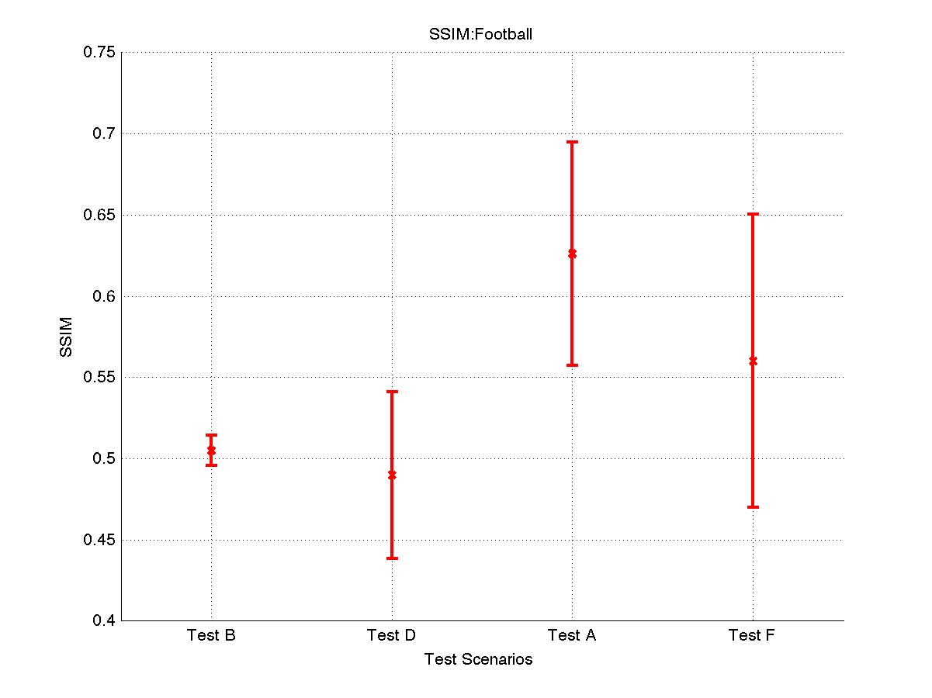
SSIM
Test | Condition
A | Baseline
B | EPB + TC1
C | EPB + TC1, TC2
D | TC1
E | TC1, TC2
F | EPB + TC1 + DPI
G | EPB + TC1, TC2 + DPI

Slide 68
Impact of Choice: Traffic Grooming
→ narrow
Broader definition
  The art and science of converging available technologies of core and access for network-wide mutual benefit
Classical definition
  OEO minimization
  Multiplexing lower rates into wavelengths
λ₁ XC
λ₁ λ₂ λ₃
λ₁ λ₂ λ₃
λ₂ XC
λ₃ XC
Incoming
Fibers
Outgoing
Fibers
“Add” from access network
“Drop” to access
Notes:
an approach of multi-layer traffic engineering that explicitly represents optical layer constraints/opportunities

Slide 69
Providing Choice
E2E Path
Search
Marketplace
⚡
⚡
⚡
-- | ------- | -------
-- | ------- | -------
-- | ------- | -------
-- | ------- | -------
-- | ------- | -------
-- | ------- | -------
Groom
Advertise
-- | ------- | -------
😊
😃
Purchase
Customer
Provider
Use
Provision
Provider provides two alternatives for every (potential) connection request: FAST (least delay); GREEN (least power)
Customer strategies
  FAST, GREEN, DELAY-PREF, ENERGY-PREF, HALF
Simulations on NSFNET, USNET
A C Babaoglu, S Huang, R Dutta

Slide 70
The Impact of Choice

Slide 71
The Impact of Choice

Slide 72
The Impact of Choice

Slide 73
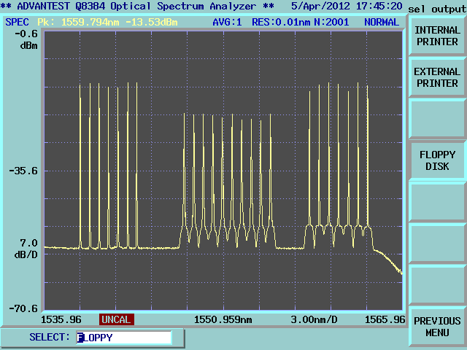




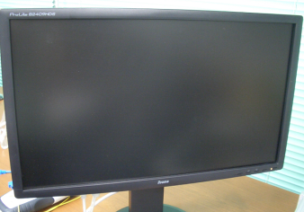

Ongoing Work: OPCINet and Choice
Optical Packet & Circuit Integrated Network (OPCINet)
User view: A “high-speed, inexpensive” service and “low delay, low data-loss” service on a single optical network
Network provider view: Large switch capacity (>100Gbps Optical Packet), energy saving, and flexible & efficient resource use under a simple control
packets
circuits
Packet sequence
Sensors, tags
Cf.: H. Harai, et.al, IEICE Trans. on Commun., March 2012.

Slide 74
Early Prototyping
Service Choice Generator
E-Plane Speaker
Marketplace
Network State Model
E-Plane Speaker
Customer Population
OPCINet simulation
Network State Monitor
D-Plane usage
Network State Agent
OPCINet C-Plane Speaker
C-Plane Agent / Speaker
OPCINet simulation
C-Plane Agent / Speaker
OPCINet simulation
C-Plane Agent / Speaker
OPCINet simulation
C-Plane Agent / Speaker
OPCINet simulation

Slide 75
Prototyping – JGN-X & OPCINet
Service Choice Generator
E-Plane Speaker
Marketplace
Network State Model
E-Plane Speaker
Customer Population
Network State Monitor
D-Plane usage
Network State Agent
JGN-X
OPCINet C-Plane Speaker
OPCI node
OPCINet

Slide 76
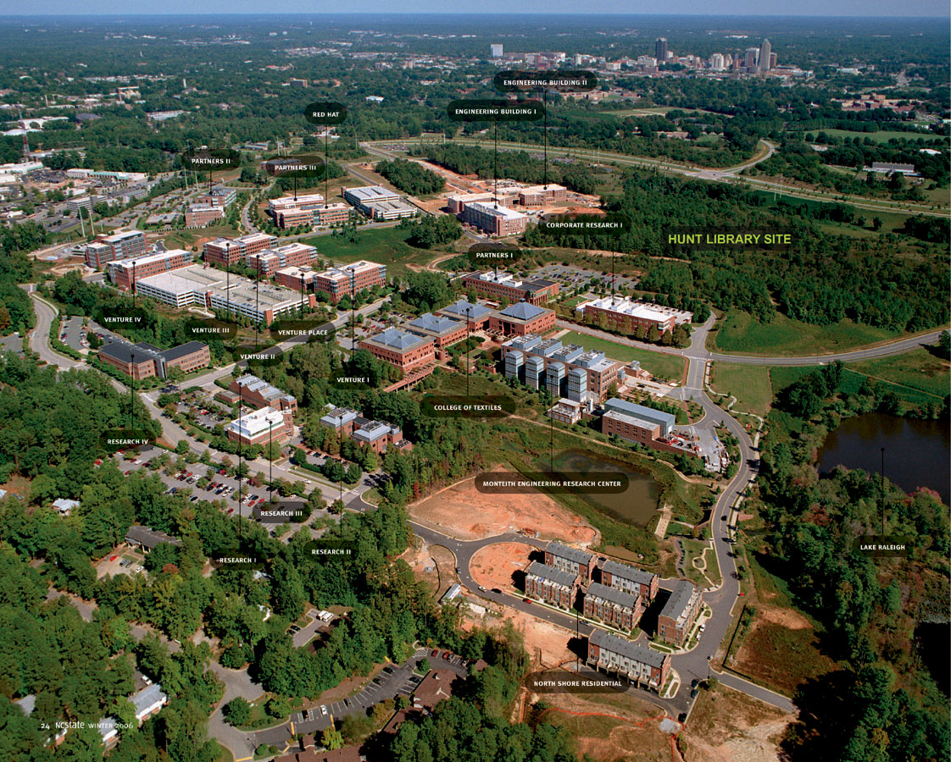
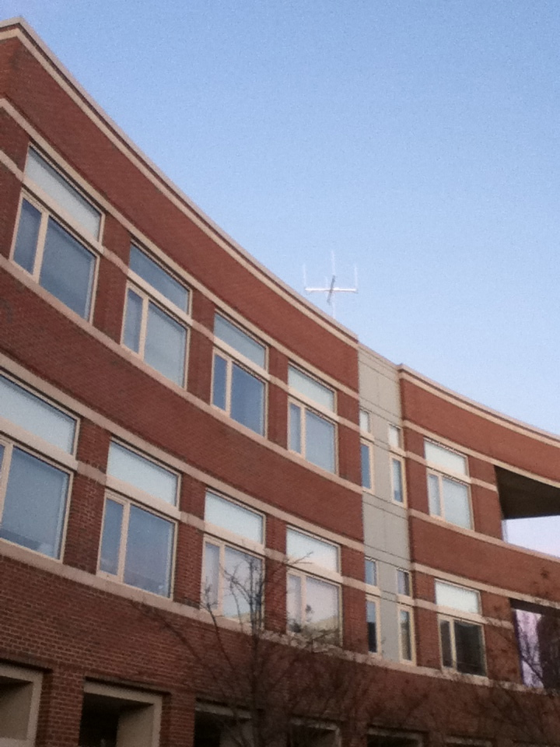
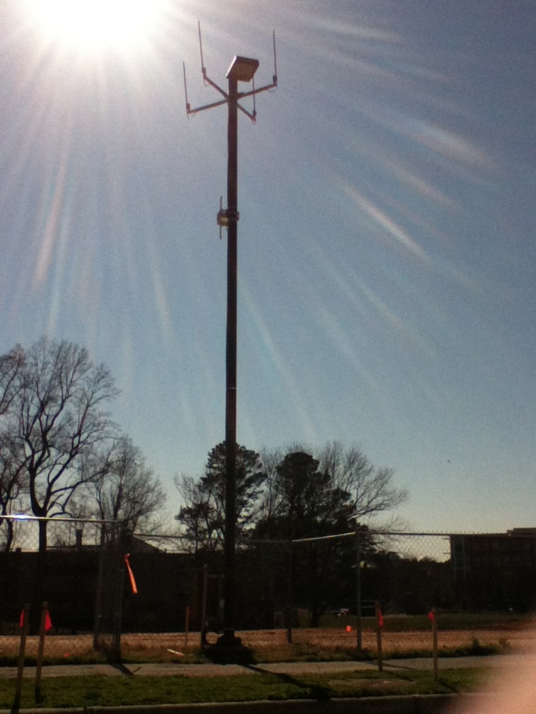
The CentMesh Project
CentMesh : a project to build a versatile, open source shared resource on campus
Provide an active testbed to support research and instruction on wireless networks
Part of NCSU’s “Living Laboratory” vision

Slide 77
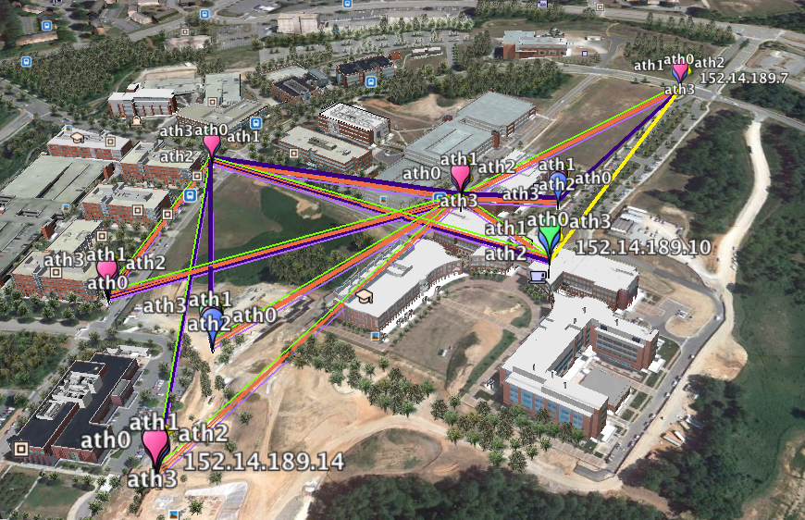

Slide 78
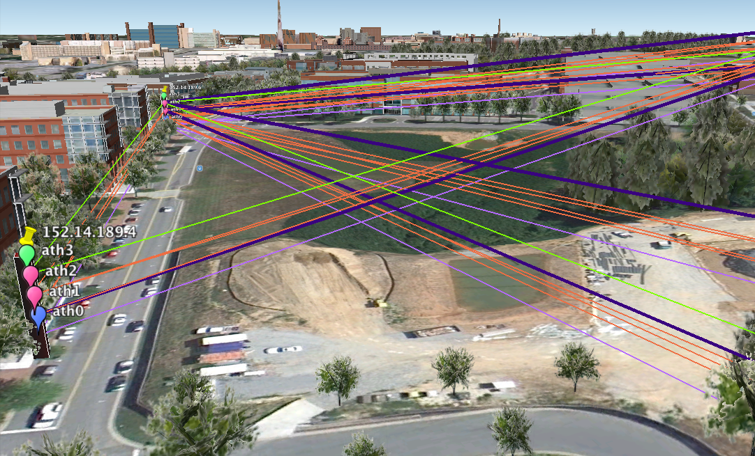

Slide 79
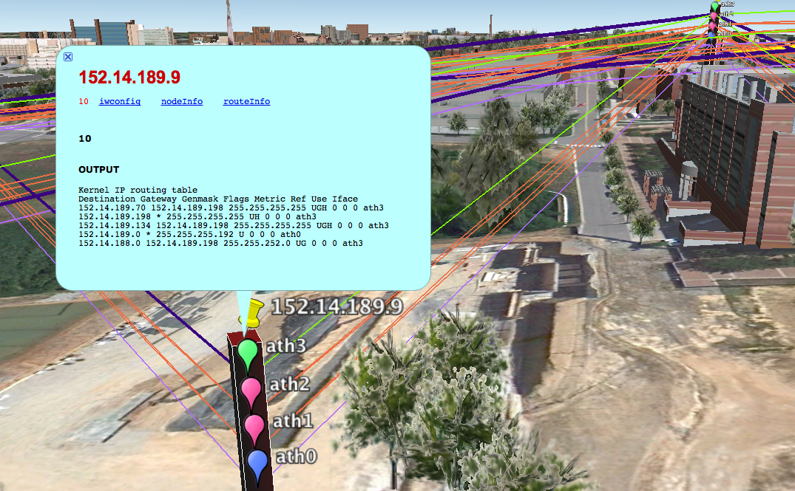

Slide 80
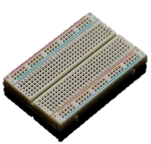
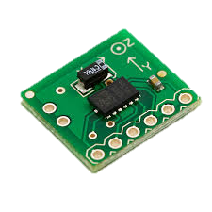

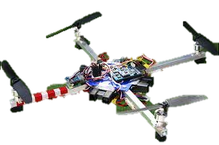
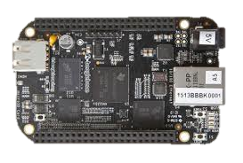
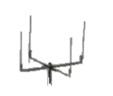

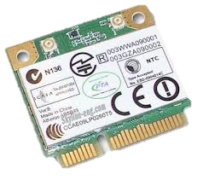
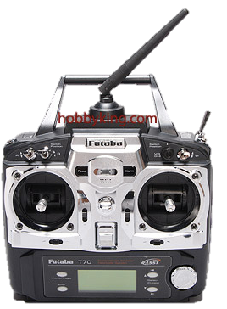

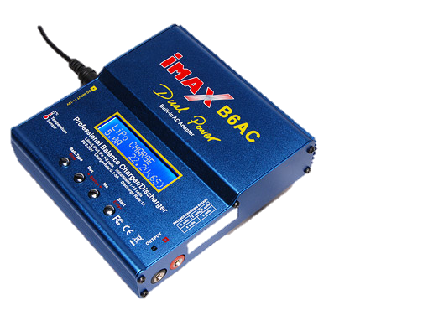
CentMesh Sensor Drone Fabrication
Sensors on
breadboard
BBBK
BBBK WiFi
Sensing, Command
Orchestration
CentMesh Node
(existing)
Autopilot/
controller
Battery
Airframe
Propellor
FM Receiver
Motor
ABORT
WiFi cards
FM Transmitter
Battery charger

Slide 81
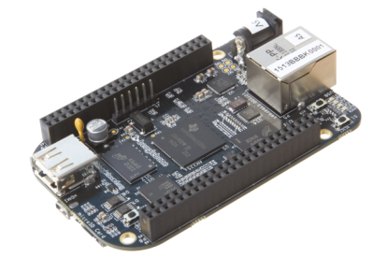

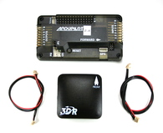

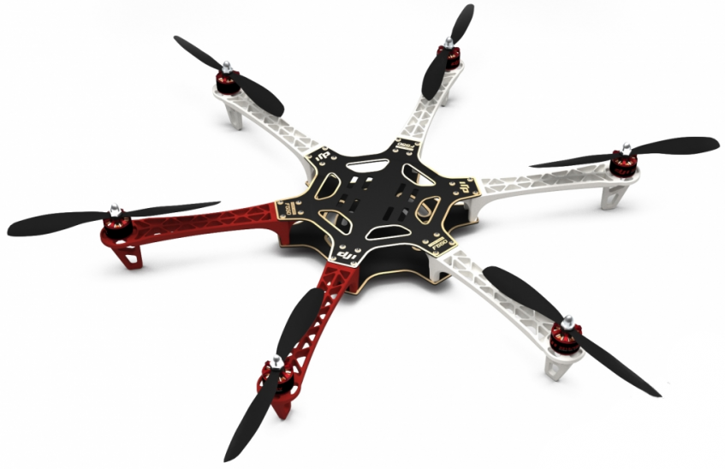
}
{
  WiFI
  CentMesh
  Mobile Node
  BBBK
MAVLink over
USB
Abort
Signal
  Autopilot
CentMesh
Drone
PWM
Commands
  Airframe

Slide 82

  CentMesh Mobile Node
MAVLink over
USB
  Autopilot
MCP over
UDP/IP
  CentMesh Drone

Slide 83


Slide 84

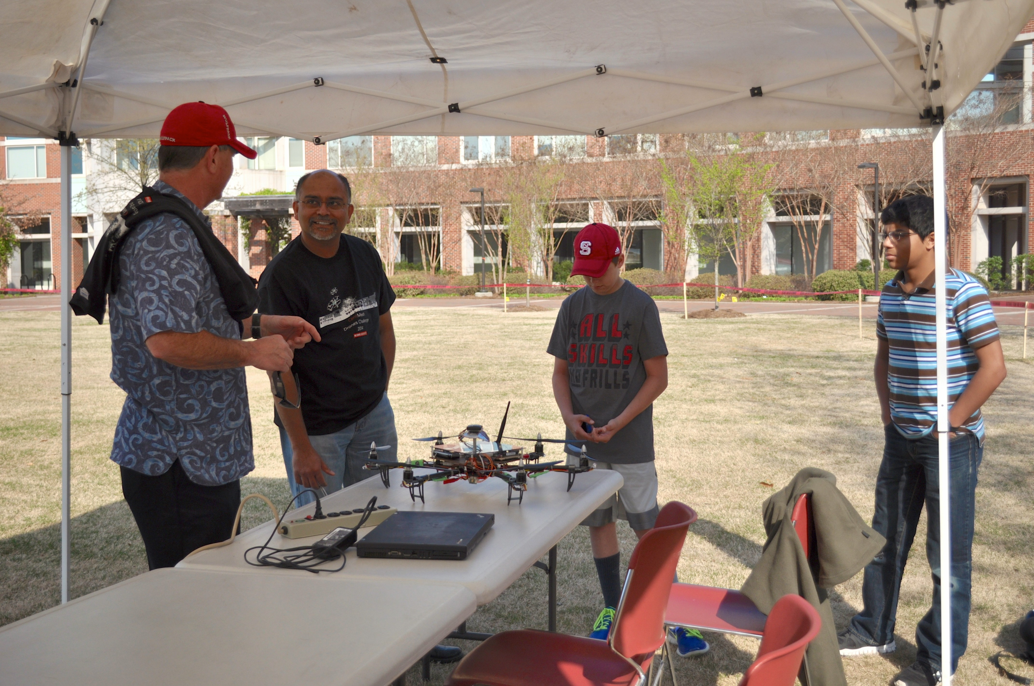
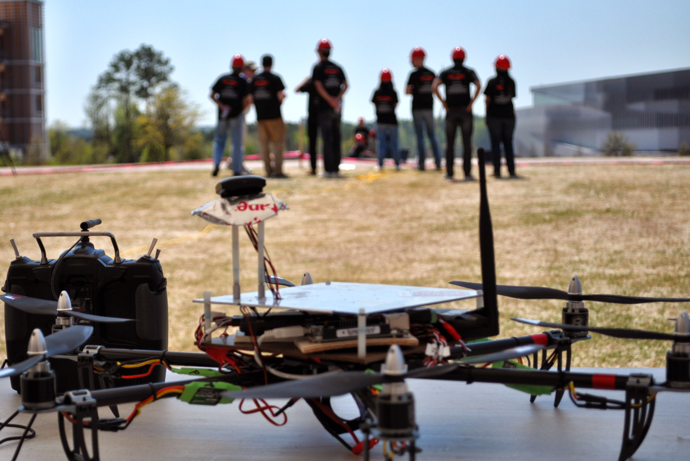
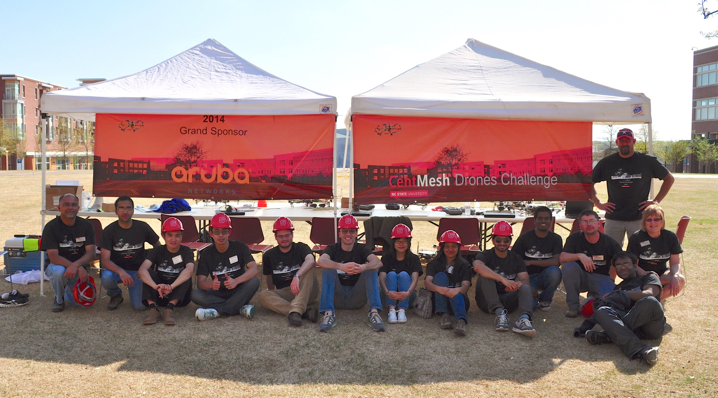
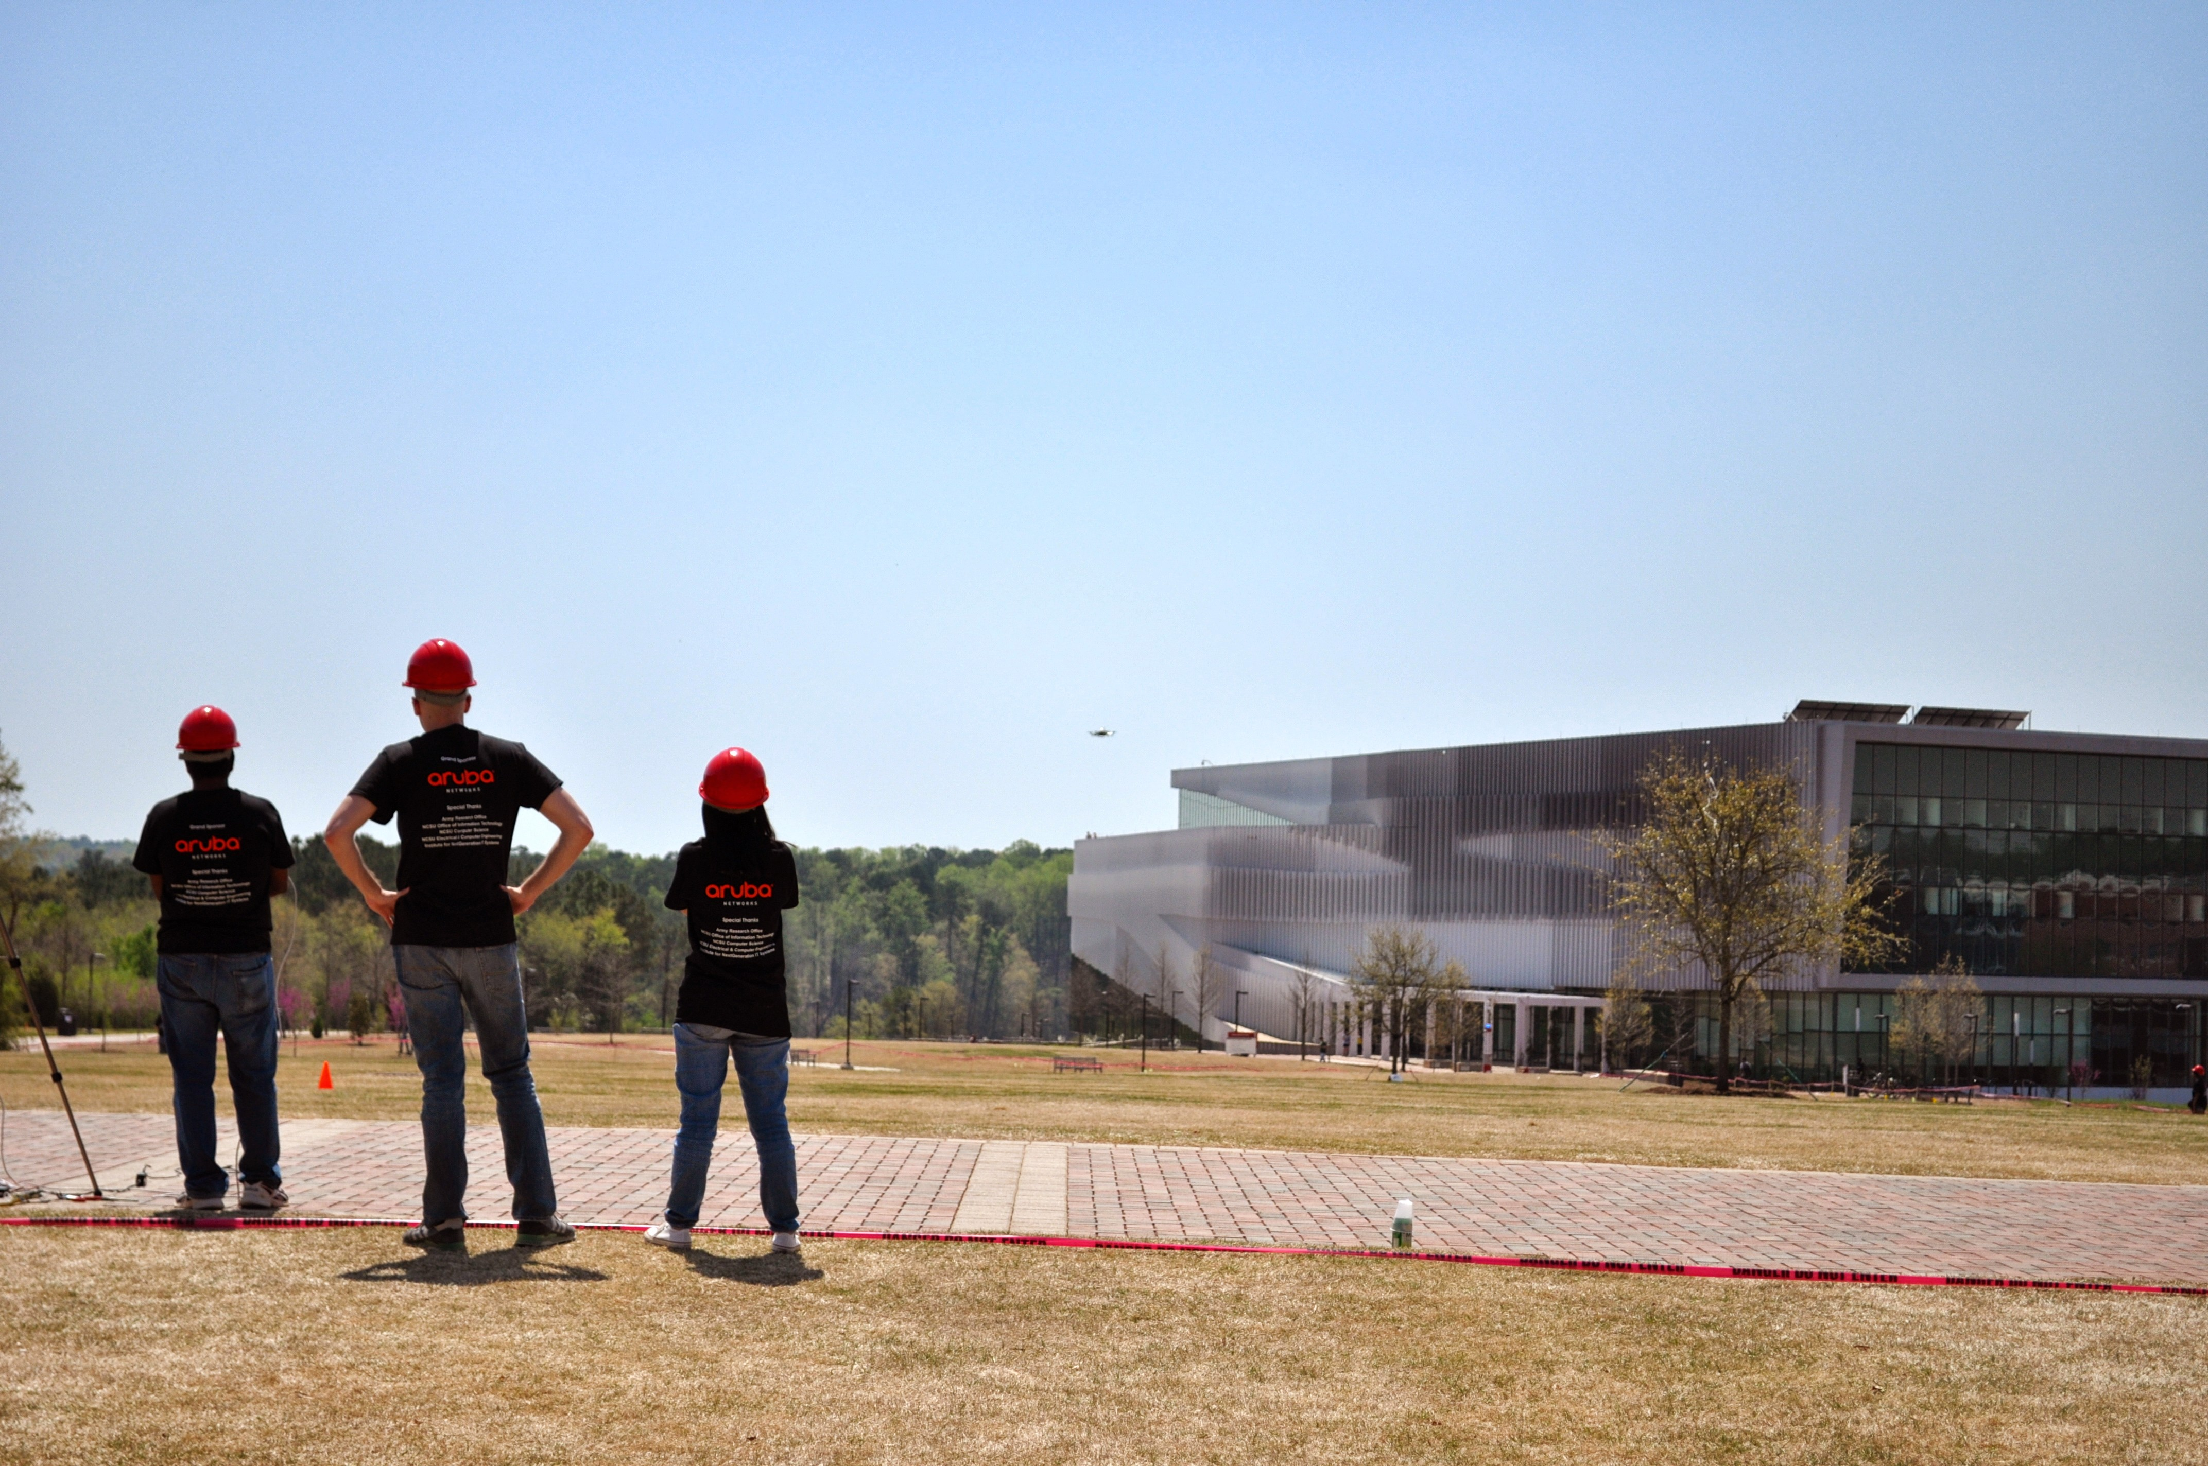
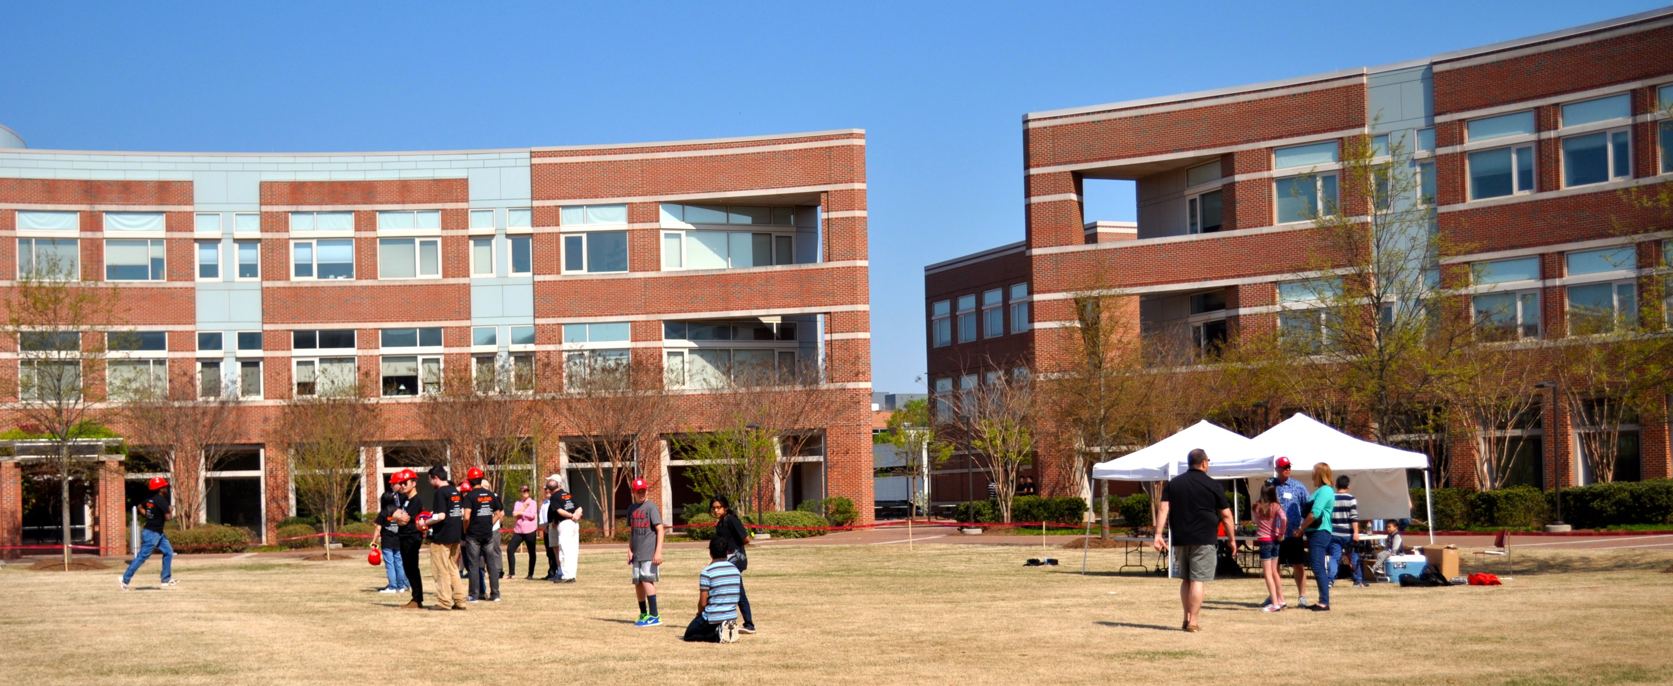
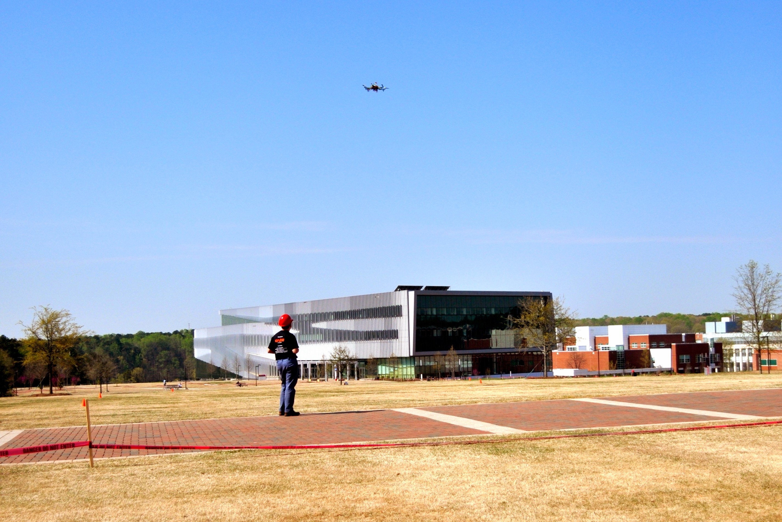
Student Programming Competition

Slide 85
Discussion
Internet Architecture: The Role of Economy and Choice in the
Services Internet
Rudra Dutta
Computer Science, North Carolina State University
ACMU Seminar
Advanced Computing and Microelectronics Unit, Indian Statistical Institute, Kolkata
July 15, 2014

