Slide 1
ChoiceNet
Internet Architecture Research
(What does THAT mean.)
(… and some other stuff)
Rudra Dutta, CSC, NCSU
SAS Lunch presentation, April, 2012

Slide 2
Future Internet – Concerns, Steps
In 2005-06, NSF created the FIND program
  ~ 20 projects funded in first round
  ~ 50 total in three years
What would the global network look like in 15 – 30 years, and how could it be built from scratch?
  How could left-by-wayside design goals be satisfied?
Underlying concern: incremental may not get us there
  Not new, but deeper
  Assumptions, priorities, “baked-in” in Internet – invisible walls
  Seeds of GENI – later
Compete and collaborate
http://www.nets-find.net/

Slide 3
Internet Roots – and Sunlight
Continuity – over loss of networks/gateways
Support multiple comm. service types
Accommodate variety of networks
Permit distributed management
Cost effective
Low barrier to host entry
Resources must be accountable
Security; trust, availability
Support pervasive computing, mobile, wireless
Clark, 88, “Design Philosophy of the DARPA Internet Protocols

Slide 4
FIND Priorities
Application-oriented architectural view
Security, trust; E2E → T2T
Economics
Social/regulatory
Flexibility, “Evolvability”
“Tussles”

Slide 5
Are the current network protocols the right protocols?
Are there any “right” protocols?
Are the same protocols right for every application?
Every host? Every physical medium?
?
Is flexibility good?
If everything is flexible, is there “a network” left?
What is “a network”, anyway?
If change is (or is supposed to be) a way of life in the Internet, is anything ever “wrong” with it?
Can you really “design for change?”
Is it true that a community is smarter than any individuals, in the long run?

Slide 6
A Reconstructed Protocol Stack
App
App
App
App
App
App
m₁₁
m₁₁
m₁₃
Transport
Transport
Cross-
Service
Tuning
silo &
service
mgmt
m₂₁
m₂₁
Network
m₃₁
m₂₁
m₃₁
m₃₁
Data Link
m₄₂
m₄₃
Physical
Tuning
strategies,
hints
m₆₂
m₆₂
m₆₁
Composability
Constraints
Physical Channels
Physical Channels

Slide 7
Service Composition
Ontology of services
  Constraints on composition
    Relations - “requires”, “not / above” “not / immediately above”
  Application provides some service requirements
    “Need encryption”
Composition
  Find a permissible ordering for (expanded) set of services
Later - ontology as a repository for :
  Recipes, policies, tuning strategies, reasoning about performance effects

Slide 8
Ontology - Networking Knowledge
Primitive
ServiceFunction
ServiceType
Constraint
Method
Service
Functional
Primitive
Simple
Compound
Segmentation
Encryption
Ordering
Primitive
Functional
ErrorCorrection
AddressLookup

Slide 9
Software Architecture
App
class SILO_API {
public:
SILO_API() {
//silo_id = 0;
_request_id_init=0;
}
//build up a set of requires/forbids constraints
//such as: APP requires/forbids services A->B->C->NULL
ERROR_CODE create_required_srv (int request_id, list<srv_ID> srv_list);
ERROR_CODE create_forbidden_srv (int request_id, list<srv_ID> srv_list);
ERROR_CODE release_request(int request_id);
//...
};
// register a silo, load the needed DSOs
RecipeId RegisterRecipe(const string &recipe);
// remove a recipe
void DestroyRecipe(const RecipeId &recipeId);
// create a new silo given a recipe ID
SiloId CreateSilo(const RecipeId &recipeId);
// delete a silo
void DestroySilo(const SiloId &siloId);
RecipeId GetRecipeIdForSilo(const SiloId &siloId);
SILO Management
Method
Method
Method
Method
Method
SILO Construction
silo
// manages a collection of silos and passes data through them
class SiloManager {
public:
typedef unsigned int RecipeId;
typedef unsigned int SiloId;
static SiloManager &Instance();
// process data
void ProcessTxBuffer(const SiloId &siloId, unsigned char *buf);
void ProcessRxBuffer(const SiloId &siloId, unsigned char *buf);
class SILO_Knob
{
public:
SILO_Knob() { ; }
inline int get_max() {return _knob_intf.nMax;}
inline int get_value() {return _knob_intf.nValue;}
inline bool set_value(int nValue) {
_knob_intf.nValue = nValue;
return true;
}
//...
};
SILO Tuning
Ontology of Services,
Composability Constraints,
Recipes, Tuning Strategies

Slide 10
Market-Enabling Architecture
John Musacchio, Jean Walrand, Venkat Ananthram, Galina Schwartz, Shyam Parekh
  User should be offered choice between network services and informed of benefits, then the market can play itself out
  Security could be achieved by “security insurance” provided by Certification Agency

Slide 11
Service Choice
Users offered real-time choice: “red” and “blue”
  “Red” and “blue” not specified to users in detail
  ISP incentivized to improve along dimensions that matter
  Unlike ATM, IntServ, DiffServ, service definitions not standardized
John Musacchio

Slide 12
Internet Today – Security Inadequacy
ANALOGY
Zzzz
Drivers do not bear full cost of reckless driving.
Liability insurance incentivizes drivers to be careful.
Users do not bear full cost of poor computer maintenance
John Musacchio

Slide 13
Markets for Security
Example:
  Users pay to be certified by a Certification Agency (CA)
  CA takes on liability for attacks traced back to user
  CA incentivized to encourage users to take due care
$
Zzzz
OS Update
Antivirus Update
John Musacchio

Slide 14
Postcards from the Edge
Roy Yates, Dipankar Raychaudhuri, Sanjoy Paul, James Kurose
Cache-and-forward
  Reliable hop-by-hop transport of large files
  Push-pull architecture for opportunistic delivery of files both to and from the wired network
  Enhanced naming to provide location information for mobile terminals
  Distributed caching of popular content to make peer-to-peer file sharing a first-class service and to enable efficient reliable multicast.

Slide 15
Architectural Support for Selectively-Connected End Systems
Mark Allman, Vern Paxson, Ken Christensen, Bruce Nordman
Enable an energy-efficient future Internet
Baked-in assumption of always-on
  Fate sharing
  Soft-state
  E2E
Study how architecture should change for real current devices
  Proxy, “limbo”, assistant

Slide 16
Future Internet Architecture
In 2009-10, NSF created the FIA program
  Build on FIND, NetSE, leverage GENI
  Integrate; nearly complete architectures
Four large projects funded
  Named Data Networking
  Mobility First
  Nebula
  eXpressive Internet Architecture
Similar focus as FIND, but also
  Economic viability
  “Deployabilty”, (“realizability”?)
http://www.nets-fia.net/

Slide 17


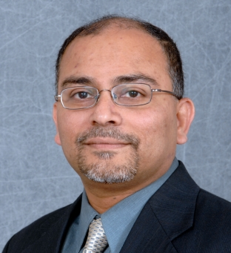




ChoiceNet
NSF NeTS Large project
  Inducted into FIA
Team:
  University of Kentucky:
  Jim Griffioen, Ken Calvert
  North Carolina State University:
  Rudra Dutta, George Rouskas
  RENCI:
  Ilia Baldine
  University of Massachusetts:
  Tilman Wolf, Anna Nagurney

Slide 18
ChoiceNet Principles
Expose choices throughout protocol stack
Interactions between technological alternatives and economic interactions
“Encourage alternatives”
  Provide building blocks for
  different types of services
“Know what happened”
  Ability of evaluate services
“Vote with your wallet”
  Reward good services through “money protocol”
Encourage
Alternatives
Vote with
Your Wallet
Know What
Happened

Slide 19
ChoiceNet Architecture

Slide 20
ChoiceNet Example
Choices for movie streaming
  Technical choices: different connections, transport, caching, etc.
  Economic choices: pay more for better experience
User experience
  Offer better service for a price
ChoiceNet infrastructure
  Identify choices, compose suitable offering
  Distribute money among providers
  Verify performance (or determine whom to blame)

Slide 21
ChoiceNet Research
Research thrusts
  Technologies for alternatives
    Routes, transport, services, etc.
    Verification and payment
  Choice and composition
    Presentation of choice
    Measurement architecture
    Ontological approach
  Economics of choice
    Pricing, matching
    Incentives, cooperation vs. competition
Cross-thrust issues
  Predictability, stability
  Interface to user/apps
  “blocks”, “players”
  End-to-end scaling
Prototype
  GENI prototype
  Component prototyping
  Long-standing GENI experiment
  Addressing scalability
  Teaching use
  Assessment

Slide 22
Questions Abound
Users – “chusers” ?
  Producers / consumers / intermediaries
  Which actors have influence over what
Economic Viability
  Industry structure and business models
  Provider ecosystem
Control / Policies
  Which actors have ability to block communication?
Interfaces among actors
  Information exchanged between providers?
  Inter-provider agreements?
  Negotiation and cooperation between providers?
Trust, Isolation, and Availability
  Instrumentation and data gathering
  Detection of non-functioning actors and response

Slide 23
GENI
In late 2000’s, an NSF initiative to create a national-scale sharable network testbed
Allow researchers to experiment with a national “at-scale” footprint
Allow experimentation with different architectures, fundamentally incompatible
Virtualized underlying infrastructure indispensable for such a testbed
  Different experiments would be completely isolated
  Would use completely different stacks, hops
Also the thought: maybe virtualization is the next architecture

Slide 24
Network Integration
Vision of integrated services network
  Single network infrastructure which carries traffic for various types of use
But – requirements are very different
  Integrating networks requires making “greatest of all networks” (ATM) rather than “least of all networks”
  Raises barrier to entry
Separate networks are good
  For banking and videochat and telesurgery, e.g.
But frustrating that “solved” problems reappear, old solutions cannot be easily applied

Slide 25
Motivation for Virtualization
Approach similar to compute virtualization
A substrate that provides basic capabilities
A method to identify smallest units (“slivers”) of
  Bandwidth
  Switching
  Buffers
Resources that make up substrate must each be sliverable
  Easiest when slivering is along physical lines (NICs, switches)
Collection of slivers makes up a virtual network (“slice”)
  Similar to a virtual machine
Advantage of integrated network without (some of) the drawbacks

Slide 26
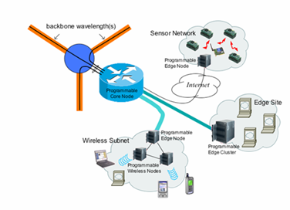






GENI Conceptual Design
Infrastructure to support at-scale experimentation
Virtualized
Deeply programmable
Programmable & federated, with end-to-end virtualized “slices”
Sensor Network
Federated International Infrastructure
Heterogeneous,
and evolving over time via
spiral development
Mobile Wireless Network
Edge Site
Notes:
26

Slide 27
Moral of this story
GENI is meant to enable . . .
  Trials of new architectures, which may or may not
  be compatible with today’s Internet
  Long-running, realistic experiments with enough instrumentation to provide real insights and data
  ‘Opt in’ for real users into long-running experiments
  Large-scale growth for successful experiments, so good ideas can be shaken down at scale
A reminder . . .
  GENI itself is not an experiment !
  GENI is a suite of infrastructure on which experiments run
GENI creates a huge opportunity for ambitious research!
Notes:
27

Slide 28
Resource discovery
Aggregates publish resources, schedules, etc., via clearinghouses
What resources can I use?
GENI
Clearinghouse
These
Researcher
Components
Components
Components
Aggregate A
Computer Cluster
Aggregate B
Backbone Net
Aggregate C
Metro Wireless
Notes:
28

Slide 29
Slice creation
Clearinghouse checks credentials & enforces policy
Aggregates allocate resources & create topologies
Create my slice
GENI
Clearinghouse
Components
Components
Components
Aggregate A
Computer Cluster
Aggregate B
Backbone Net
Aggregate C
Metro Wireless
Notes:
29

Slide 30
Experimentation
Researcher loads software, debugs, collects measurements
Experiment – Install my software,
debug, collect data, retry, etc.
GENI
Clearinghouse
Components
Components
Components
Aggregate A
Computer Cluster
Aggregate B
Backbone Net
Aggregate C
Metro Wireless
Notes:
30

Slide 31
Slice growth & revision
Allows successful, long-running experiments to grow larger
Make my slice bigger !
GENI
Clearinghouse
Components
Components
Components
Aggregate A
Computer Cluster
Aggregate B
Backbone Net
Aggregate C
Metro Wireless
Notes:
31

Slide 32
Federation of Clearinghouses
Growth path to international, semi-private, and commercial GENIs
Make my slice even bigger !
GENI
Clearinghouse
Federated
Clearinghouse
Components
Components
Components
Components
Aggregate A
Computer Cluster
Aggregate B
Backbone Net
Aggregate C
Metro Wireless
Aggregate D
Non-NSF Resources
Notes:
32

Slide 33
Operations & Management
Always present in background for usual reasons
Will need an ‘emergency shutdown’ mechanism
Stop the experiment
immediately !
Oops
GENI
Clearinghouse
Federated
Clearinghouse
Components
Components
Components
Components
Aggregate A
Computer Cluster
Aggregate B
Backbone Net
Aggregate C
Metro Wireless
Aggregate D
Non-NSF Resources
Notes:
33

Slide 34
Spiral 1 integration and trial operations
Five competing control frameworks, wide variety of substrates
Reference
Design
Cluster A
Cluster B
Components
Components
Components
Components
Components
Components
Aggregate A
Computer Cluster
Aggregate B
Backbone Net
Aggregate C
Metro Wireless
Aggregate A1
Computer Cluster
Aggregate A2
Optical Network
Aggregate A3
Metro Wireless
Components
Components
Cluster C
Cluster D
Cluster E
Aggregate B1
Optical Network
Aggregate B2
Sensor Network
Components
Components
Components
Components
Components
Components
Components
Components
Aggregate C1
Computer Cluster
Aggregate C2
Programmable Switches
Aggregate D1
Optical Network
Aggregate D2
Sensor Network
Aggregate E1
Computer Cluster
Aggregate E2
Optical Network
Aggregate E3
Sensor Network
Aggregate E4
Programmable Switches
Notes:
34

Slide 35
GENI System Decomposition (simplified)
Engineering analysis drives Spiral 1 integration
NSF Clearinghouse
Federations
Operations
Researchers
GENI Aggregates
Notes:
35

Slide 36
OpenFlow
Open standard that attempts
  Virtualization
  Flow routing
Main idea: separate switching (forwarding) functionality from control logic/policy
  Use any box with forwarding mechanism to execute custom networking logic
  Basic isolation: OF traffic and regular traffic
  For OF, provide custom logic as flow definitions
  Also may attempt to detect flows
http://www.openflow.org/

Slide 37


OpenFlow
OpenFlow is an API – off a Stanford project
Control how packets are forwarded
Implemented on hardware switch
Controller
OpenFlow Firmware
Software Layer
OpenFlow Switch
PC
Flow Table
MAC
src
MAC
dst
IP
Src
IP
Dst
TCP
sport
TCP
dport
Action
OF
Protocol
Hardware Layer
*
*
*
5.6.7.8
*
*
port 1
following packets
routing
1st packet
routing
port 1
port 2
port 3
port 4
PKT
PKT
IP dst: 5.6.7.8
5.6.7.8
1.2.3.4

Slide 38
Local Connection
Triangle
  Duke U (Jeff Chase, CS) and RENCI (Baldine, Huang) are architects of GENI-ORCA
    One of four control frameworks
  RENCI coordinated BEN is part of GENI substrate
  Good working partnership resources
NCSU
  Lead in one GENI project (Integrated Measurements Framework), PI: Dutta; subcontractors: RENCI, Columbia U
  Three years, $480K (till Oct 2012)
  Build messaging plane for measurement and actuation events, enable cross-layer
  Two more 3-Year projects (as subcontractor) in Oct 2011
    GENI rack – equipment only: “standard” rack of equipment with compute, comm, s/w
    GENI GIMI – larger integration of I&M, main involvement in years 2 and 3

Slide 39
GENI Futures
Follows fairly strict and professional software release practices
(Very large) wiki to keep all informed of all corners of GENI
Research
  May become litmus test for seriousness of research proposals, results
  Expanding into computing and storage resources
Connections with other initiatives

Slide 40
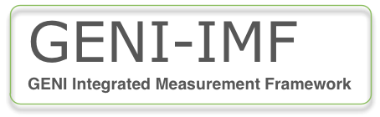



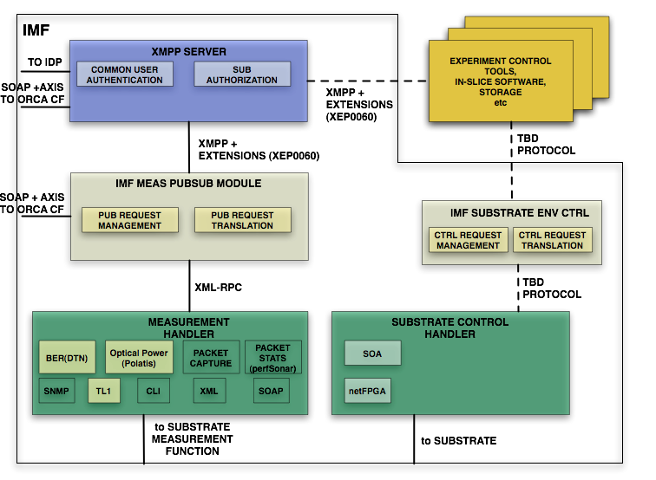
XML-RPC
pS client
XML-RPC

Slide 41
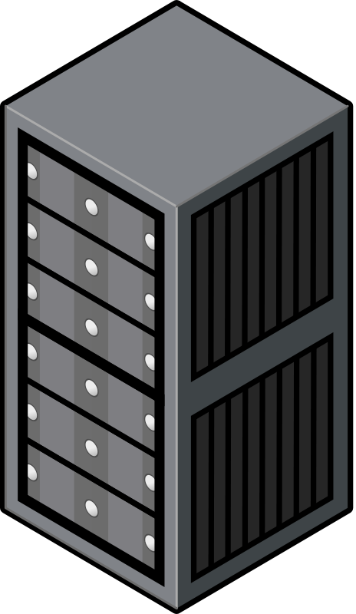


GMS Demo
Cert/cred generate
(gcf)
Openfire web portal
Openfire logs
Client credent
-ials
Generating client certificates/credentials
CA Cert
GENI CA
Client credentials
Chat client communication
OMF-like EC-RC experiment
GENI Messaging Service (XMPP)
GENI Cert
Replace OMF EC cert → connect fails
Repository Service
Restore cert, expire credentials → connects, msg fails
Chat clients
+ certs
Repo service
+ certs
OMF-like EC + RC
OMF-like AM
GENI Cert
GENI Cert
Chat
GENI Cert
OMF RC-like (stub)
OMF EC-like (stub)
Start Repository service → show RC / PSM msgs archived
Repo DB
IMF PSM logs
+ certs
Flukes

Slide 42
Campus GENI Infrastructure
“GENI campus”
  At a minimum: houses a rack providing VMs, switching, OF and understanding GENI Control Framework, fronting some experimental resources to GENI experimenters
  Full scale: All or a large part of campus network is GENI-fied, OF-aware
  Federation benefits
Currently trying for NSF CC-NIE program
  Supplementary or transformational high-bw infrastructure
  Not GENI-specific but strong encouragement

Slide 43
CentMesh – Original Vision
The Centennial Mesh project aims to build a highly programmable, extensible, open, outdoor wireless testbed to support research and education on the design of wireless mesh networks, as well as IT systems and applications enabled by wireless mesh networks, using open source code built by NCSU students and faculty, and re-using other open source code
Prove and transition IT research in pervasive computing and cybersecurity
Part of original SOSI proposal - also funded by DURIP grant – both from ARO
In planning and design/development (and permissions!) for 2+ years
Equipment ordering now mostly complete
In process of deployment – ITng (OSCAR Labs) overseeing

Slide 44
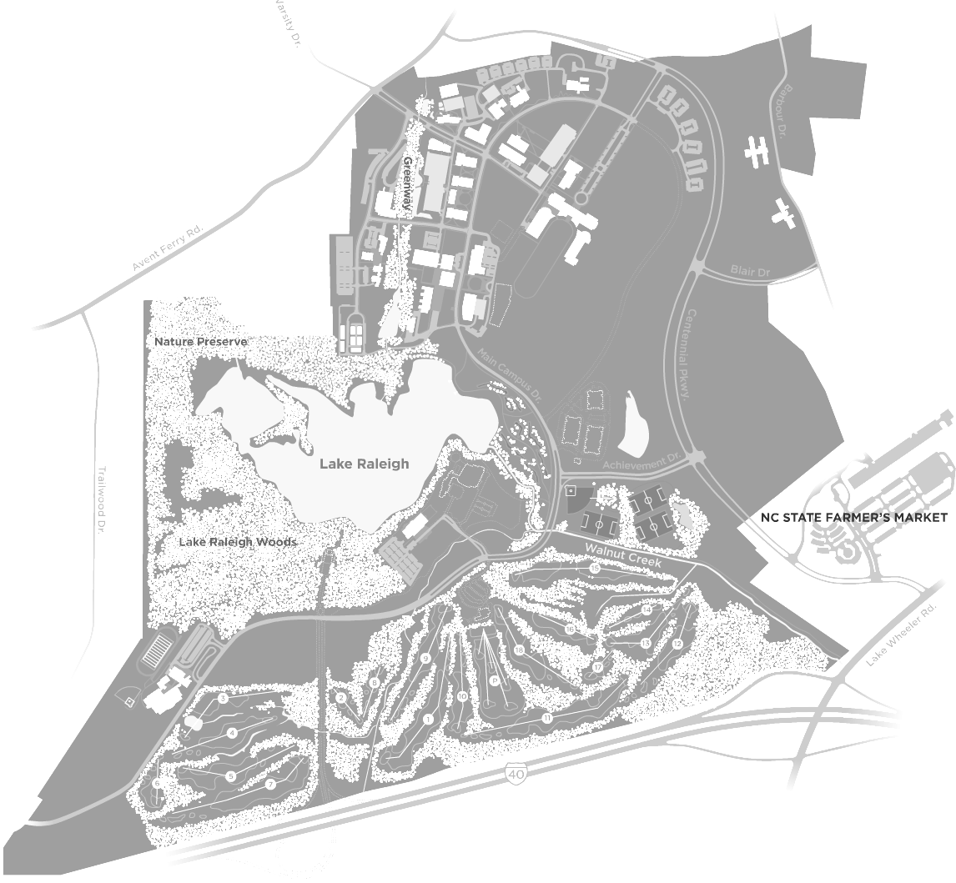
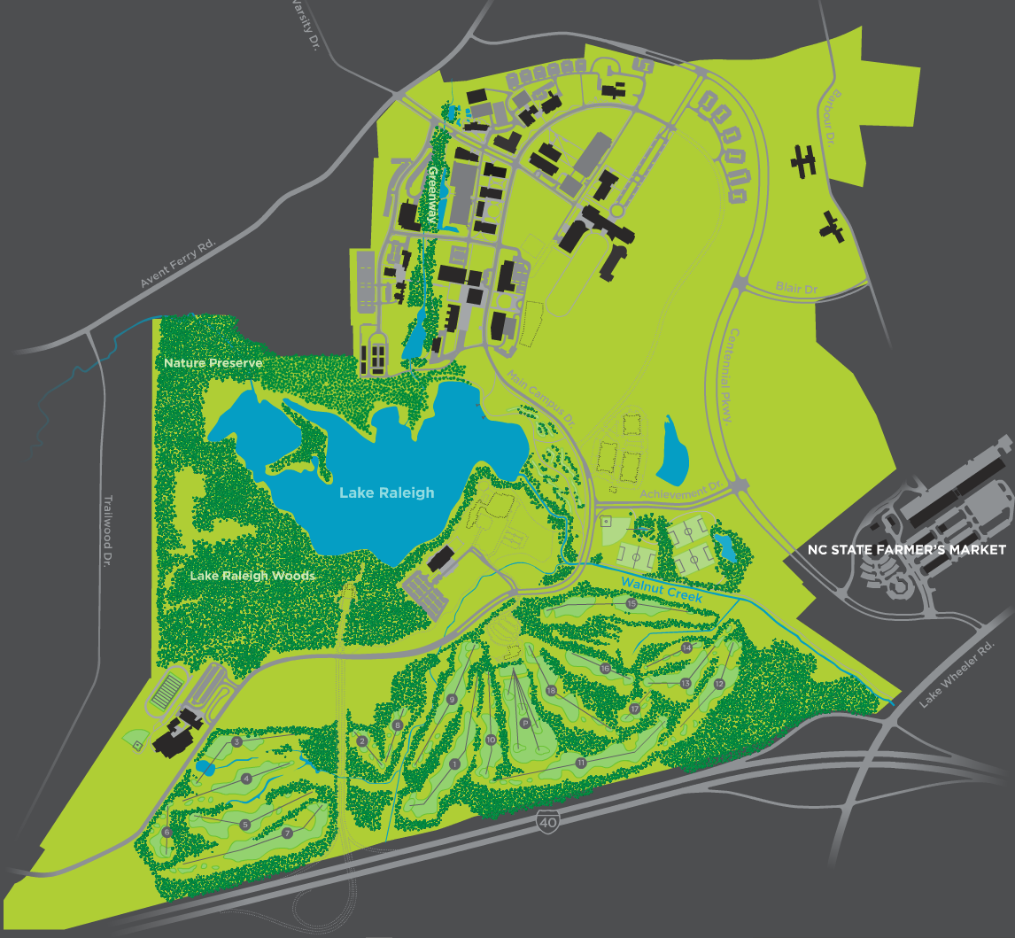
Operational
Commercial
Testbed
Slicing/sharing at wire access,
Throttling (duty cycle)
experimental at MAC,
(Channel Control)
In-bldg ncsu/guest, outdoor coverage
Experimental .
Testbed
Physical Proximity,
Power Control
Commercial Testbed Node
Experimental Testbed Node
Zones 1, 2, 3

Slide 45
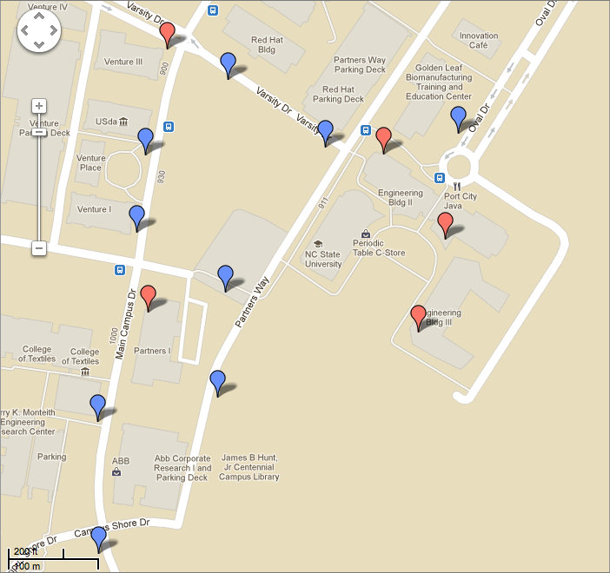

Slide 46
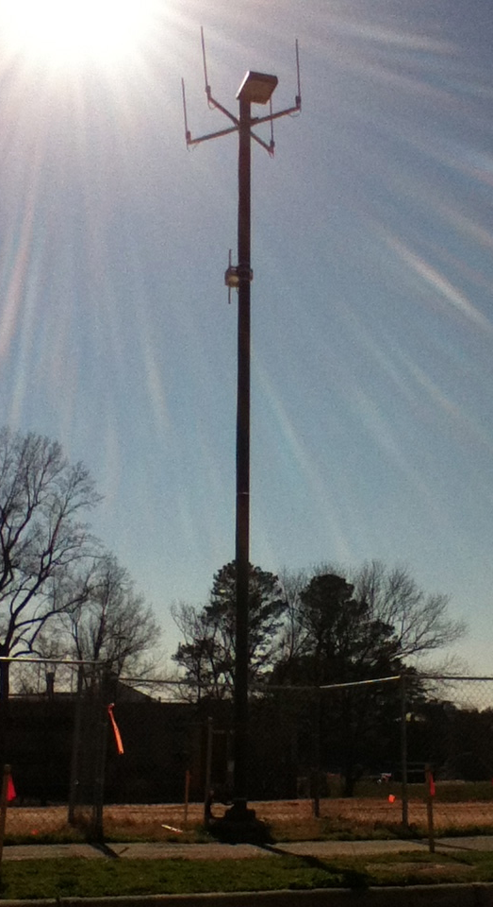
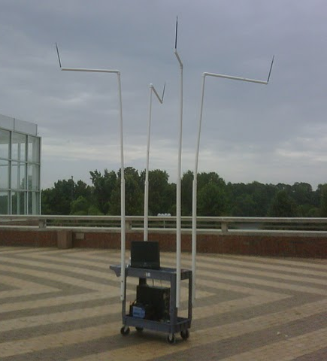
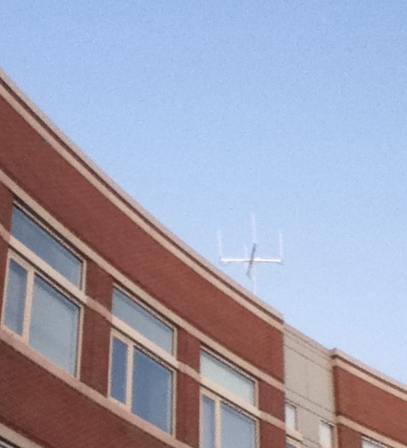
CentMesh Nodes

Slide 47
Software Architecture
Central control/management node
All control/signaling traffic is channeled through the communicator module
  Embeds control plane policies such as spectrum usage
  Uses TCP connections between mgmt and mesh nodes
  Uses automatic pub/sub mechanism locally, manual/programmatic pub/sub across nodes (planned extension to complete automatic pub/sub in future)

Slide 48
Software Architecture
Mgmt node contains a data repository
  Acts as decoupling intermediary between various data collection/dissemination procedures
Management software modules implemented in general as paired managers and agents
  Managers and agents are clients to communicator
  Managers interact with data repository

Slide 49
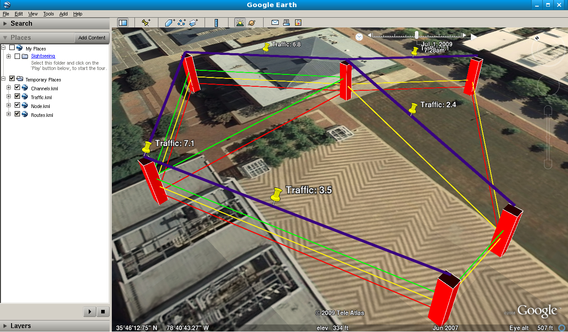
Software Architecture
Servers for typical OAM tasks also attaches to data repository
  Clients may run on control node or elsewhere on Internet
  Visualization currently implemented this way
  Scripting planned to work this way (will adapt from past existing testbed implementation)

Slide 50
Using CentMesh Software (or not)
User
Core
System
Multi-stage boot
BIOS
“Images”

Slide 51
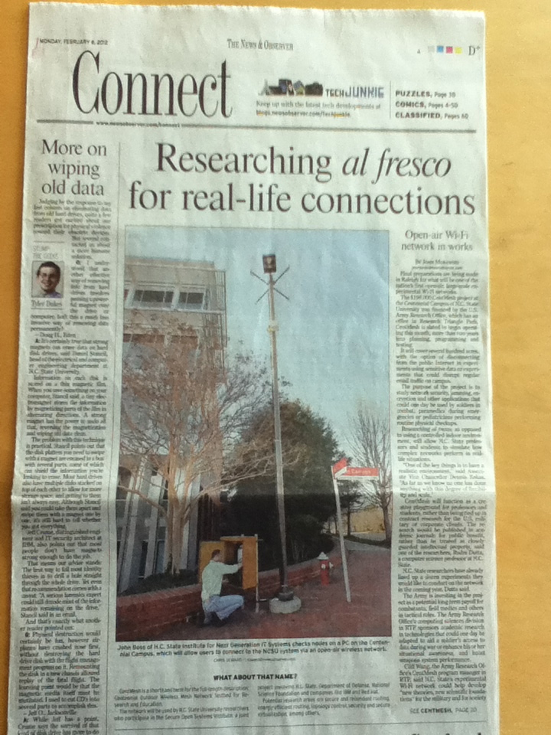
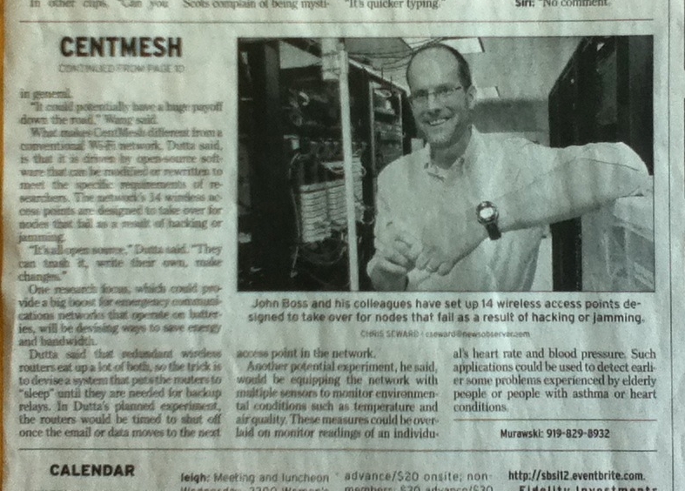

Slide 52
CentMesh Research
Network Design
Augmented Reality Apps
CentMesh : Smart programmable Wireless
Social Sciences
Smart Grid
Transportation Planning

Slide 53
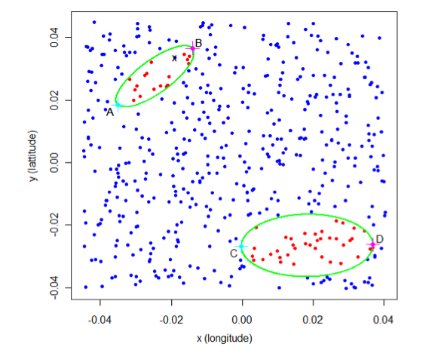
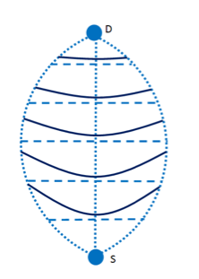
Redundant Routing (Diffuse/Disjoint)

Slide 54
Improving Wireless Back-pressure
A
6
9
E
Urgency weight
(1) on CD for E = 9K - 6K = 3K
(2) on CD for F = 3K - 2K = 1K
C
D
B
2
3
F
How to allow medium access that is urgency-proportional in presence of varying packet size traffic?

Slide 55
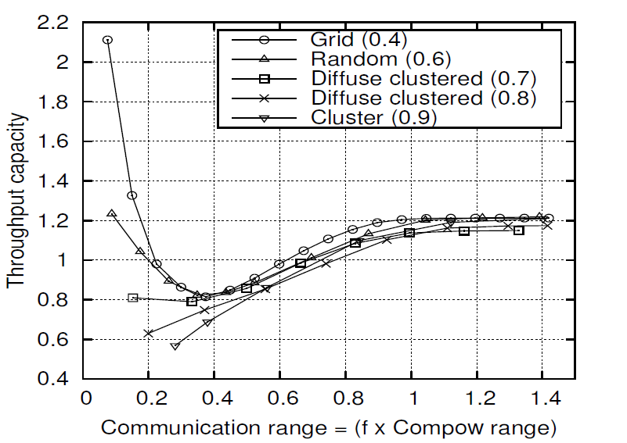

Impact of Power Control in Mesh
`
`

Slide 56

Autonomous Smart Sensor

Slide 57
Sensed Data
Sensed Data,
Digested Data
Location Control
Data request,
priority

Slide 58
Hierarchical
messaging
Model sparse data
Global Digests
Information Diffusion
Decompose model
Swarm control
Stability
Information sharing with neighbors
Sensing & Movement
Local Directives
Regional Directives
Global Directives
Individual Sensor Mission
Joint optimi-zation
Platoon Mission
Predictive control
Platoon Organization

Slide 59
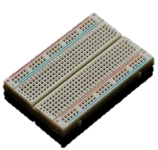
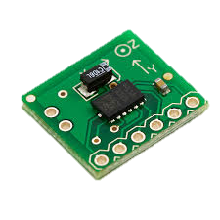

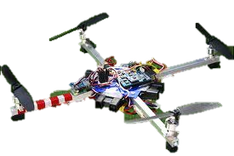
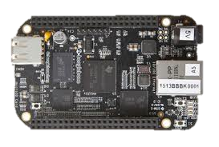
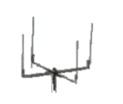

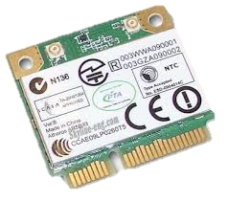
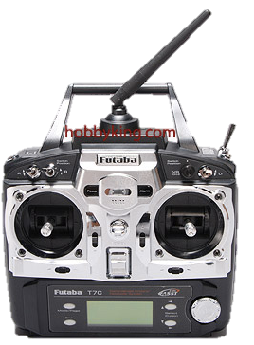

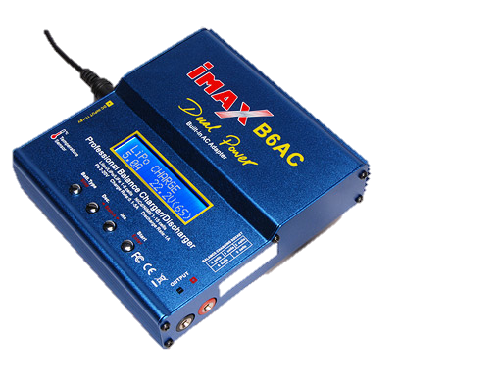
Sensors on
breadboard
BBBK
BBBK WiFi
Sensing, Command
Orchestration
CentMesh Node
(existing)
Autopilot/
controller
Battery
Airframe
Propellor
FM Receiver
Motor
ABORT
WiFi cards
FM Transmitter
Battery charger

Slide 60

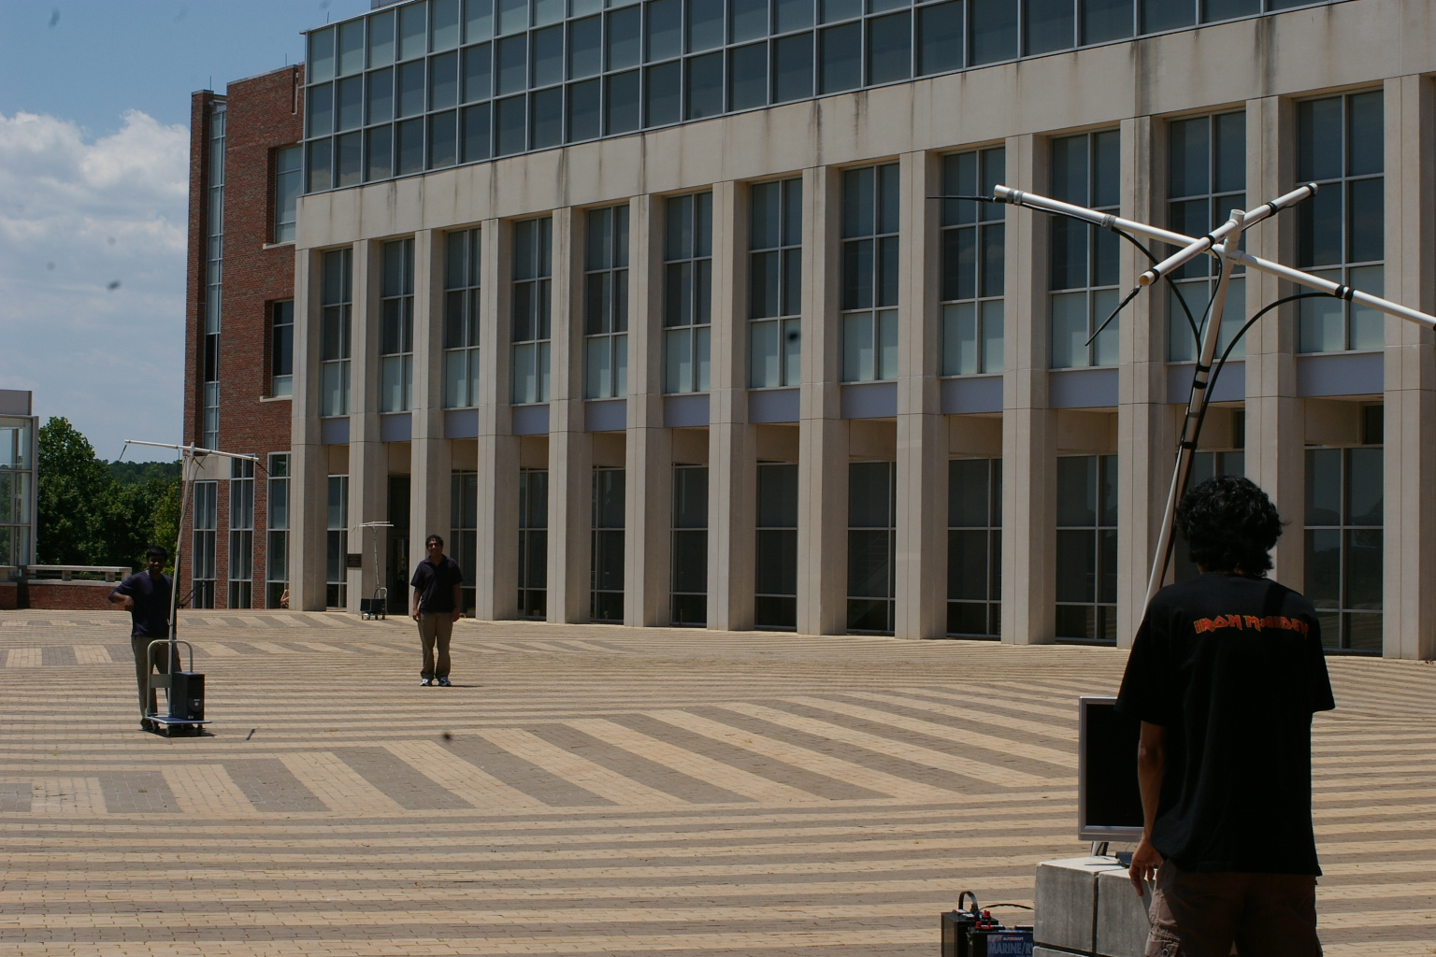
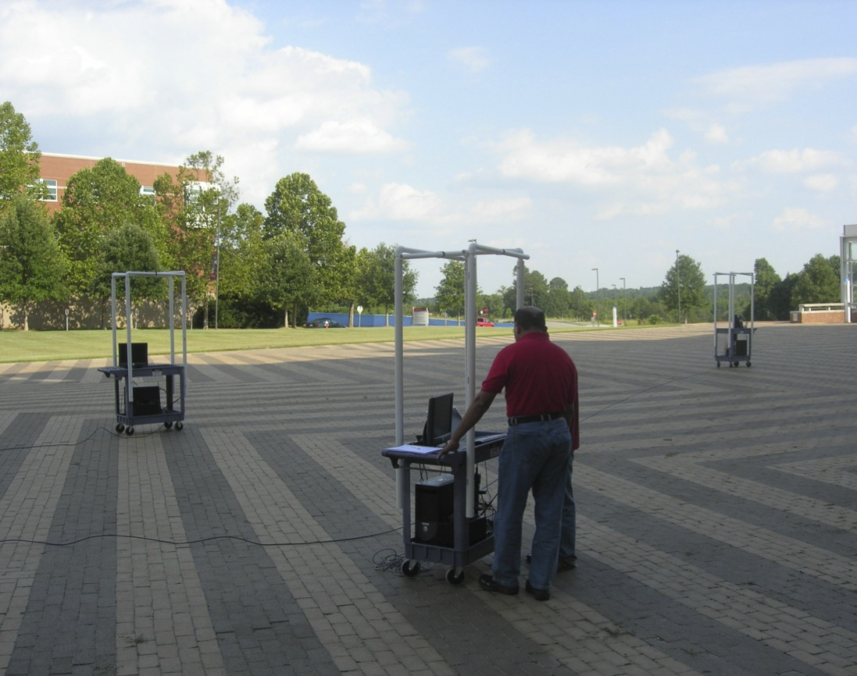

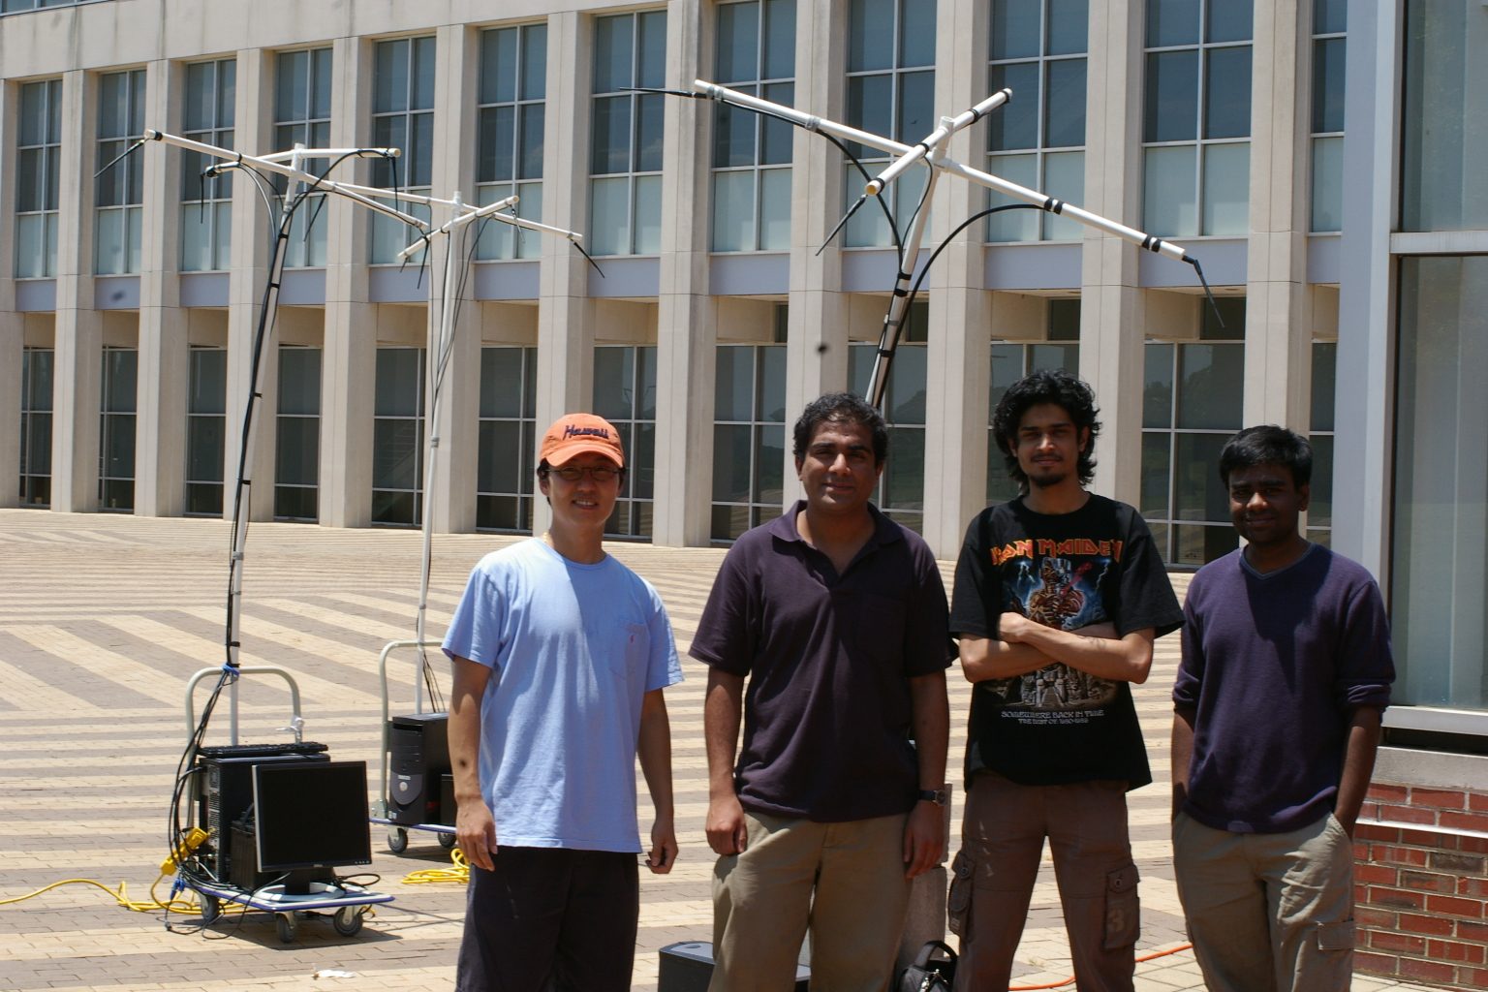
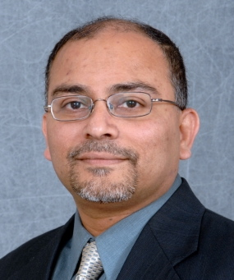
centmesh.csc.ncsu.edu
itng.ncsu.edu

Slide 61
  3) Decoupling Measurement and Analysis
Marker Mechanism:
Measuring and matching the same “metric” across MPs
User’s sending rate may vary
Add “marker” information to application PDU
Timestamp the first marker packet M₁ as t₁
Count the number of bytes, called B till the next marker packet M₂ received at t₂
When M₂ is received, send( 2, t₁, t₂, B ) as MD
Granularity is based on the user

Slide 62

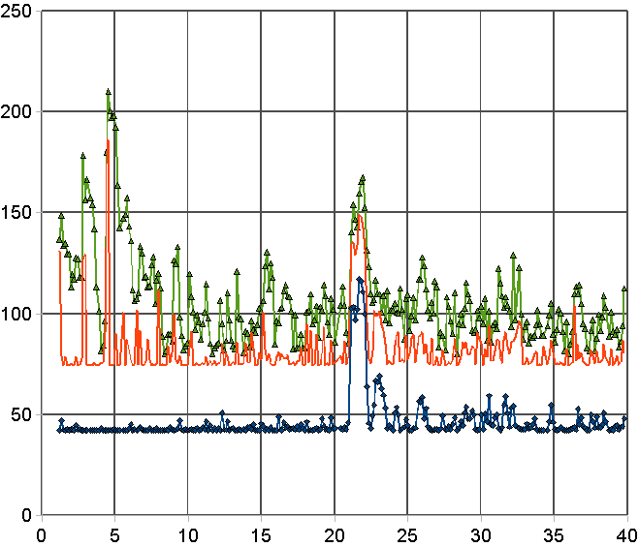
  3a) Simple Throughput Measurement
One-way delay measurement across MPs
Time (s)
Delay (ms)
Marker Sequence Number
Time (s)

Slide 63
  3a) Simple Throughput Measurement
Overhead benefit comparison;
Based on the results of previous research papers
Using rough calculations and approximations
At least one order of magnitude less network load than all existing approaches
This is of the nature of “easy way to do difficult problem”
Accuracy: >50%
Accuracy: 10%-20%

Slide 64
  3b) Jitter Apportionment for Video Streaming Experience Quantification
At this level of data examination, NSP3 is clearly to blame

Slide 65
  3b) Jitter Apportionment for Video Streaming Experience Quantification
A freeze
A glitch
Glitches denote the losses and Freezes denote video player freezes

Slide 66
  3b) Jitter Apportionment for Video Streaming Experience Quantification
Systematic analysis produces “apparent surprise”: NSP1 is equally to blame
Analysis for freeze 1 [t=6 and t=10]
Freeze 1 is at t=8s
Delay (ms)
 | Mean % | Std dev % | Max J %
NSP1 | 96.7 % | 93.8 % | 94.7 %
NSP2 | 0.2 % | 0.6 % | 0.2 %
NSP3 | 3.1 % | 5.6 % | 5.1 %
Freeze 2 is
at t=10s
Analysis for freeze 2 [t=8 and t=12]
 | Mean % | Std dev % | Max J %
NSP1 | 98.5 % | 97.2 % | 97.2 %
NSP2 | 0.0 % | 0.0 % | 0.0 %
NSP3 | 1.5 % | 2.8 % | 2.8 %

Slide 67

Working Application of Optical Equipment Control in GENI
Integrated
Measurement
Framework
→ Make it possible for measurements to be exchanged between substrates and GENI slices
→ XMPP server enhanced with GENI credentials for authentication/authorization
→ Different modes for real-time measurement/actuation loop suitable for control, and offline archival
→ Plugs in with perfSONAR and OMF if desired, also carries NetKarma event records
→ Early demonstration at GEC8, GEC12, GEC13
XML-RPC
XML-RPC
→ Video stream between hosts, through Polatis / Infinera
→ BER / port power measurements from optical layer to stack protocol
→ Attenuate one path, application switches to another path
→ Improves video
→ Rudimentary but shows promise of approach

Slide 68
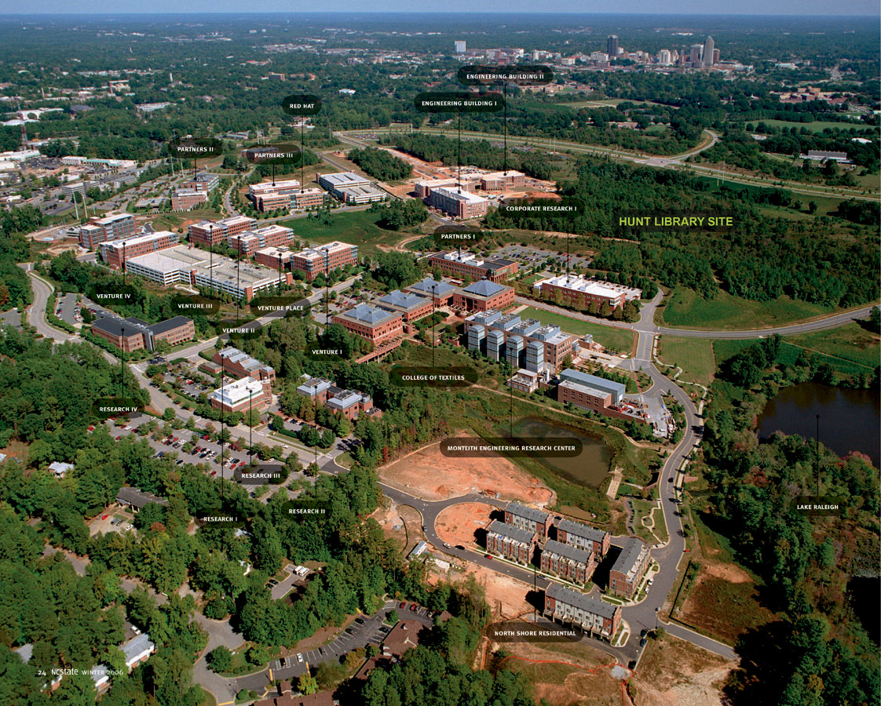
What is CentMesh ?
CentMesh : a project to build a versatile, open source shared resource on campus
Provide an active testbed to support research and instruction on wireless networks
Part of NCSU’s “Living Laboratory” vision
An extensible, programmable, open, real outdoor wireless network
A teaching and research resource at NCSU Centennial
centmesh.csc.ncsu.edu

Slide 69




Who Built CentMesh ?
Homemade !
  Built by NCSU student researchers
  Guided by NCSU faculty
  Funded by Army Research Office and NCSU
  Operationalized by Institute of Technology of Next Generation (ITng), NCSU

Slide 70
Designing CentMesh
Modular programming library
Clear separation of data, control, management functions
Easy to innovate in some or many parts, keep others unchanged
Currently working on sensor/actuator expansion
  SmartAir (see Sichitiu talk)
Ideally suited for instrumenting of networking and distributed computing, human mobility, transportation, …
A general-purpose testbed for analytic tool/science ?

Slide 71
Control Theory
Collaboration with U New Mexico, funded by Science of Security Lablet
  Many computing/networking things can be seen as feedback systems
  Use control theory to characterize
Characterize routing policies by reachability analysis of linear system description
  Multihop wireless (redundant routing algorithm), OLSR

Slide 72
Example
1
2
3
1
2
Nodes: {1,2,…,9} Links: {e₁₂,e₁₄,e₂₃,…,e₈₉} = 12 total
Goal is to reach node s = 9
2
3
4
4
1
5
1
6
Possible controls:
Link state q: if all links are working at time 0
3
4
3
7
2
8
2
9
Link costs:
i.e. c₁₂=1, c₁₄=2, etc.
We also include “holding” cost of 5 if we choose to stay in same node, i.e. c_{ii}=5
State transition function:
i.e. once we choose a feasible node to move to given q_{t}, we move to that node with probability 1
with
So at each time step we choose a node u_{t} to travel to based on current location and current state of the links.
Our “look-up table” is given by the function , which tells us where to go next based on current state. We find by solving

Slide 73
Solution: Dynamic Program
Time N (Working backwards):
  Set
Time k = N-1, …, 1:
  For i = 1,…,8 (don’t include node 9 because once at node 9, we stay there with 0 cost)
    For ( )
      Define as the set of nodes packet can reach from node i given link conditions described by state q. If is empty, set u=i and incur cost c_{ii}.
      Set
At time k=1, gives shortest expected path (expected value of shortest path) starting from node i with starting link conditions q.
We also have the function which provides a look-up table indicating which node to travel to at time k+1 given packet is in node i at time k, and link conditions are described by q.
with M a large number

Slide 74
Results
Over N=10 time steps (so packet must reach node 9 within 10 time steps), what are expected shortest path lengths given various starting link conditions?
Node | 1 | 2 | 3 | 4 | 5 | 6 | 7 | 8 | 9
 | 9.66 | 8.01 | 7.54 | 6.01 | 4.54 | 3 | 4.67 | 2 | 0
Expected shortest path length (cost) starting from each node, given all links are active at time 1, i.e.
Node | 1 | 2 | 3 | 4 | 5 | 6 | 7 | 8 | 9
 | 12.05 | 8.06 | 7.58 | 6.06 | 4.58 | 3 | 4.70 | 2 | 0
Expected shortest path length (cost) starting from each node, given links (1,4) (2,3) are inactive at time 1, i.e.
Node | 1 | 2 | 3 | 4 | 5 | 6 | 7 | 8 | 9
 | 13.79 | 9.74 | 8.35 | 7.74 | 5.35 | 3 | 14.8 | 10.74 | 0
Expected shortest path length (cost) starting from each node, given links (8,9) (7,8) are inactive at time 1, i.e.

Slide 75
Routing Policies
Look-up Table when all links are up at each step (same as deterministic shortest path algorithm). Here N=5, so that packet must reach Node 9 within 5 time steps, in order to demonstrate what happens to routing algorithm when a packet cannot reach destination in time.
1
2
3
Time | K=1 | K=2 | K=3 | K=4
Node
1 | 4 | 2 | 2 | 2
2 | 5 | 5 | 1 | 1
3 | 6 | 6 | 6 | 2
4 | 5 | 5 | 5 | 5
5 | 6 | 6 | 6 | 4
6 | 9 | 9 | 9 | 9
7 | 8 | 8 | 8 | 8
8 | 9 | 9 | 9 | 9
9 | 0 | 0 | 0 | 0
4
5
6
7
8
9
Note: Because we are limited to 5 time steps, after time k=2, Node 1 can no longer make it to Node 9 in time, Node 2 cannot make it to Node 9 after k=3, etc. This is why we see consistent routing for each node up to the time when it can no longer make it, at which point it tries to minimize link traversal costs without having a destination. Hence we see that the packet bounces back and forth between Nodes 1 and 2 when it does not have time to reach Node 9. Without a time constraint, we would get a time-independent routing table identical to column 1.

Slide 76
Routing Policies
Look-up Table when links (1,4) and (2,3) are down at times k=1 and k=2, then at time k=3 those links become active and link (8,9) goes down. Algorithm is run for N=10 time steps, but only show policies for time k=1 to k=4.
1
2
3
Time | K=1 | K=2 | K=3 | K=4
Node
1 | 2 | 2 | 2 | 2
2 | 5 | 3 | 5 | 5
3 | 6 | 6 | 6 | 6
4 | 5 | 5 | 5 | 5
5 | 6 | 6 | 6 | 6
6 | 9 | 9 | 9 | 9
7 | 8 | 8 | 8 | 8
8 | 9 | 9 | 5 | 5
9 | 0 | 0 | 0 | 0
4
5
6
7
8
9
Blue arrows indicate policy at times k=1 and k=2. At time k=3, links conditions change and policy switches to red arrows. Because of the longer time horizon, we get the consistent, stationary policy at earlier times.

Slide 77
Reachability Under Various Controllers
N=10, All links up at time 0
Centralized controller has complete knowledge of link states at all times
Fixed controller uses shortest path routing table at each time step (as calculated on slide 5). If prescribed link is down, packet is held at current node
Semi-Fixed controller only knows link states adjacent to current node. Assumes all other links are up, and picks forwarding node from shortest path routing if available, otherwise picks next best option using pre-computed controller (as in slide 3) and believed link states.
Prob. Of Reaching Node 9 in N time steps
N=5, All links up at time 0
Node
In this example, while perfect knowledge is obviously best, it seems consistently better (i.e. higher probability of reaching node 9) to hold a packet until the optimal link becomes available rather than to send it to another node without knowing the full state of the network.
Prob. Of Reaching Node 9 in N time steps
*I changed the probability of a link going down to 0.1 from 0.05 in this case.
Node

Slide 78
Shortest Path Length Under Various Controllers
Controllers same as previous slides. Let the algorithm run for 20 time steps to calculate expected shortest path length. Length greater than 20 indicates the likelihood that packet will not reach node 9 within 20 time steps.
Expected shortest path length
Node
Shortest path calculated using same dynamic program as before, only setting all edge costs to 1, including holding cost. Problem is that initial shortest path is set to a large number for all nodes but 9 in order to “drive” packet to node 9. Need to find another way to calculate shortest path length to not get the large numbers seen above when there’s a large probability packet does not reach node 9 in 20 time steps.

